Slide 1
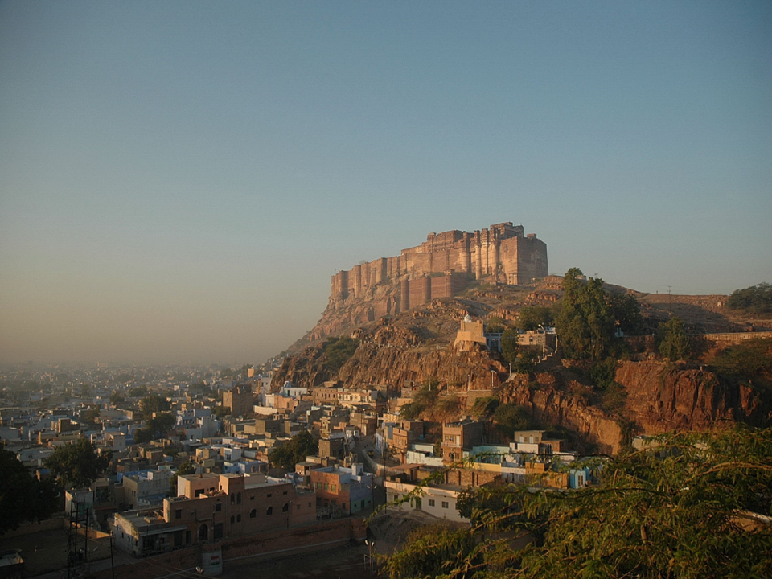
18th International Conference of National Trusts
27-31 March 2019, National Trust of Bermuda
PANEL:
Revenue Generation and Retail Best Practices
29 March 2019
STARTING FROM SCRATCH:
Three Case Studies from India
Maureen Liebl

Slide 2
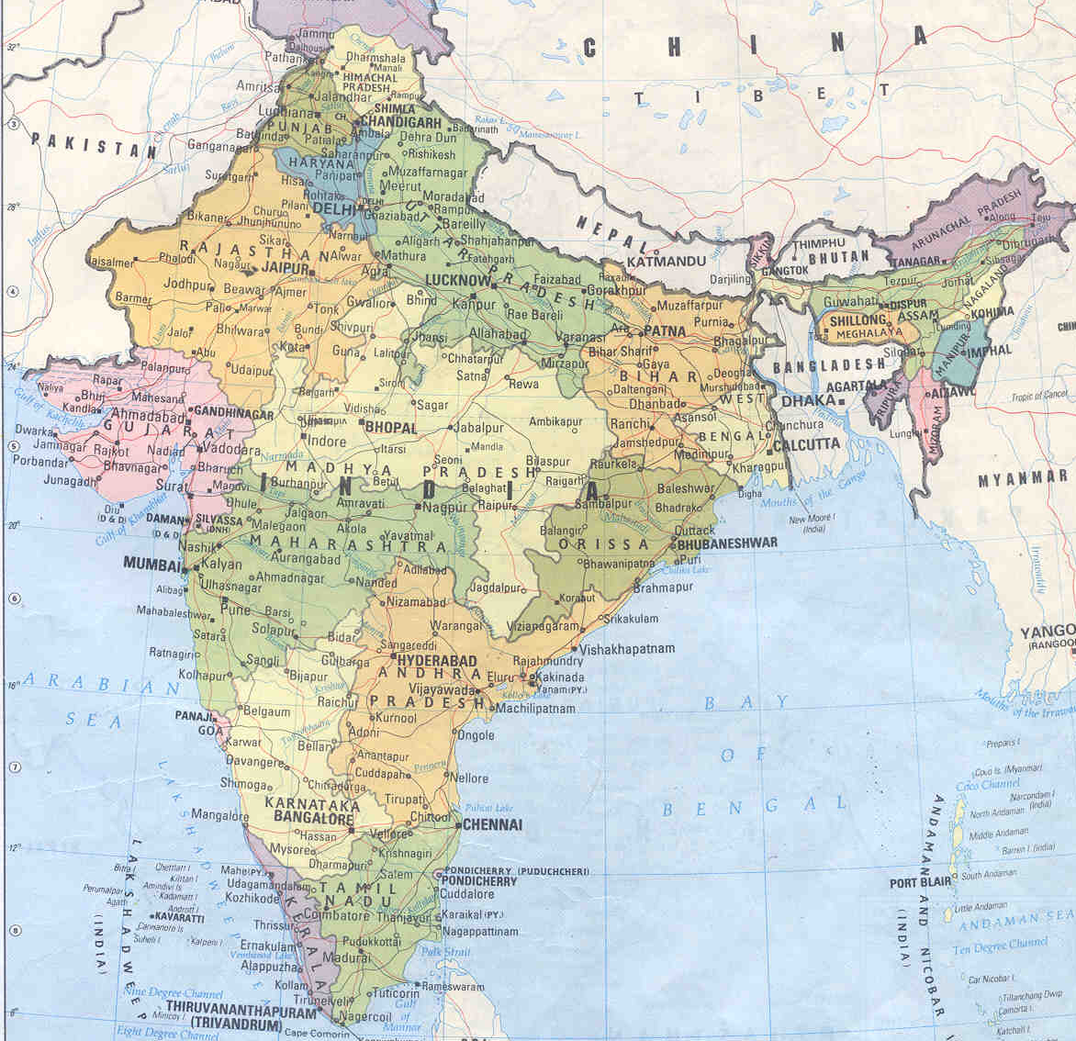

Slide 3
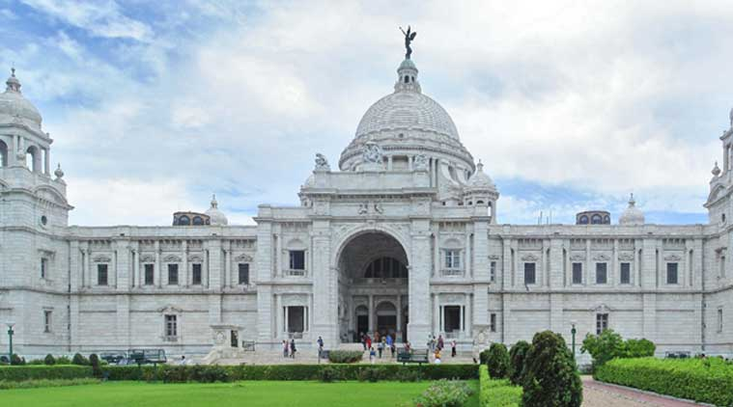
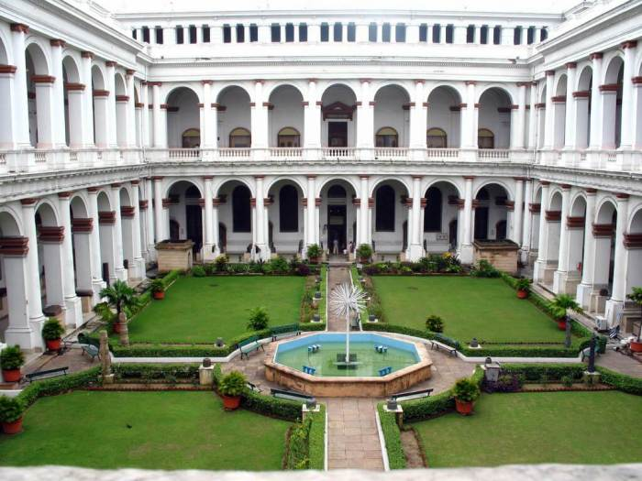
India has one of the world’s oldest museum and heritage consciousness histories.
The Indian Museum in Kolkata (Calcutta) was founded in 1814; it is still the largest and most important museum in India.
Today there are close to 200 museums of any significant size scattered throughout the country.

Slide 4
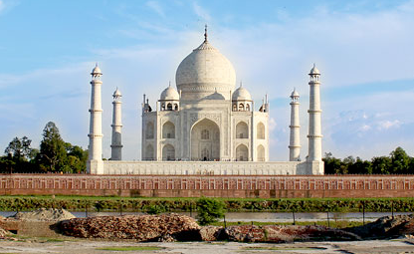
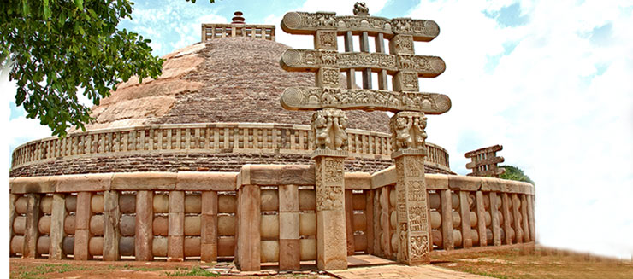
The Archaeological Survey of India was formally established in 1871. Today it oversees over 3,500 monuments and sites, small and large, that have been classified as of national importance. State Archaeological Departments oversee thousands more.

Slide 5
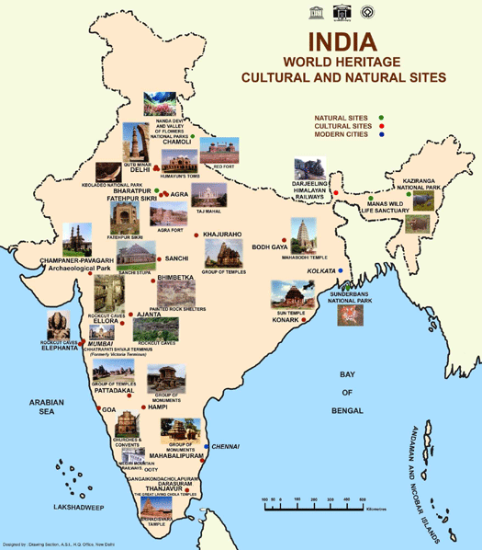
In addition,
India
now possesses
32
World Heritage Sites

Slide 6
Yet in spite of this great wealth of cultural and heritage treasures, as late as the mid-1990s, India did not possess a single professional
museum shop.
A few of the larger museums offered some publications and plaster of paris reproductions of sculptures, tucked into dusty corners.
Otherwise, the concept and the potential were unknown.

Slide 7
It fell to the Mehrangarh Museum Trust, custodian of the 15th century Mehrangarh Fort in Jodhpur, western Rajasthan, to take the plunge, in 1998. D.

Slide 8
Since then, the Mehrangarh Museum Shop has served as a model and inspiration.
The team that created and manages the Jodhpur shop have since then undertaken several other projects. All have been an unqualified success, proving the extraordinary power of cultural commerce to support institutions.
Brief case studies of three very different Indian projects are presented here.
We hope they will encourage others
to take the plunge!

Slide 9
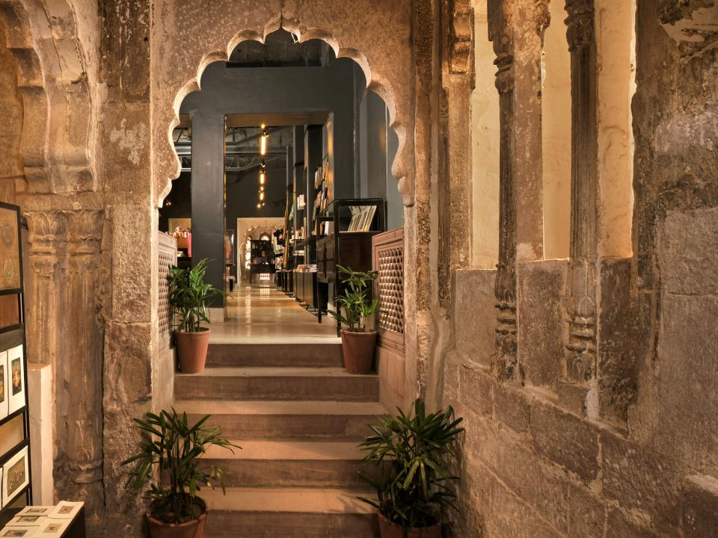
C A S E # 1
The Mehrangarh Museum Shop
Mehrangarh Fort
Jodhpur, Rajasthan
India

Slide 10
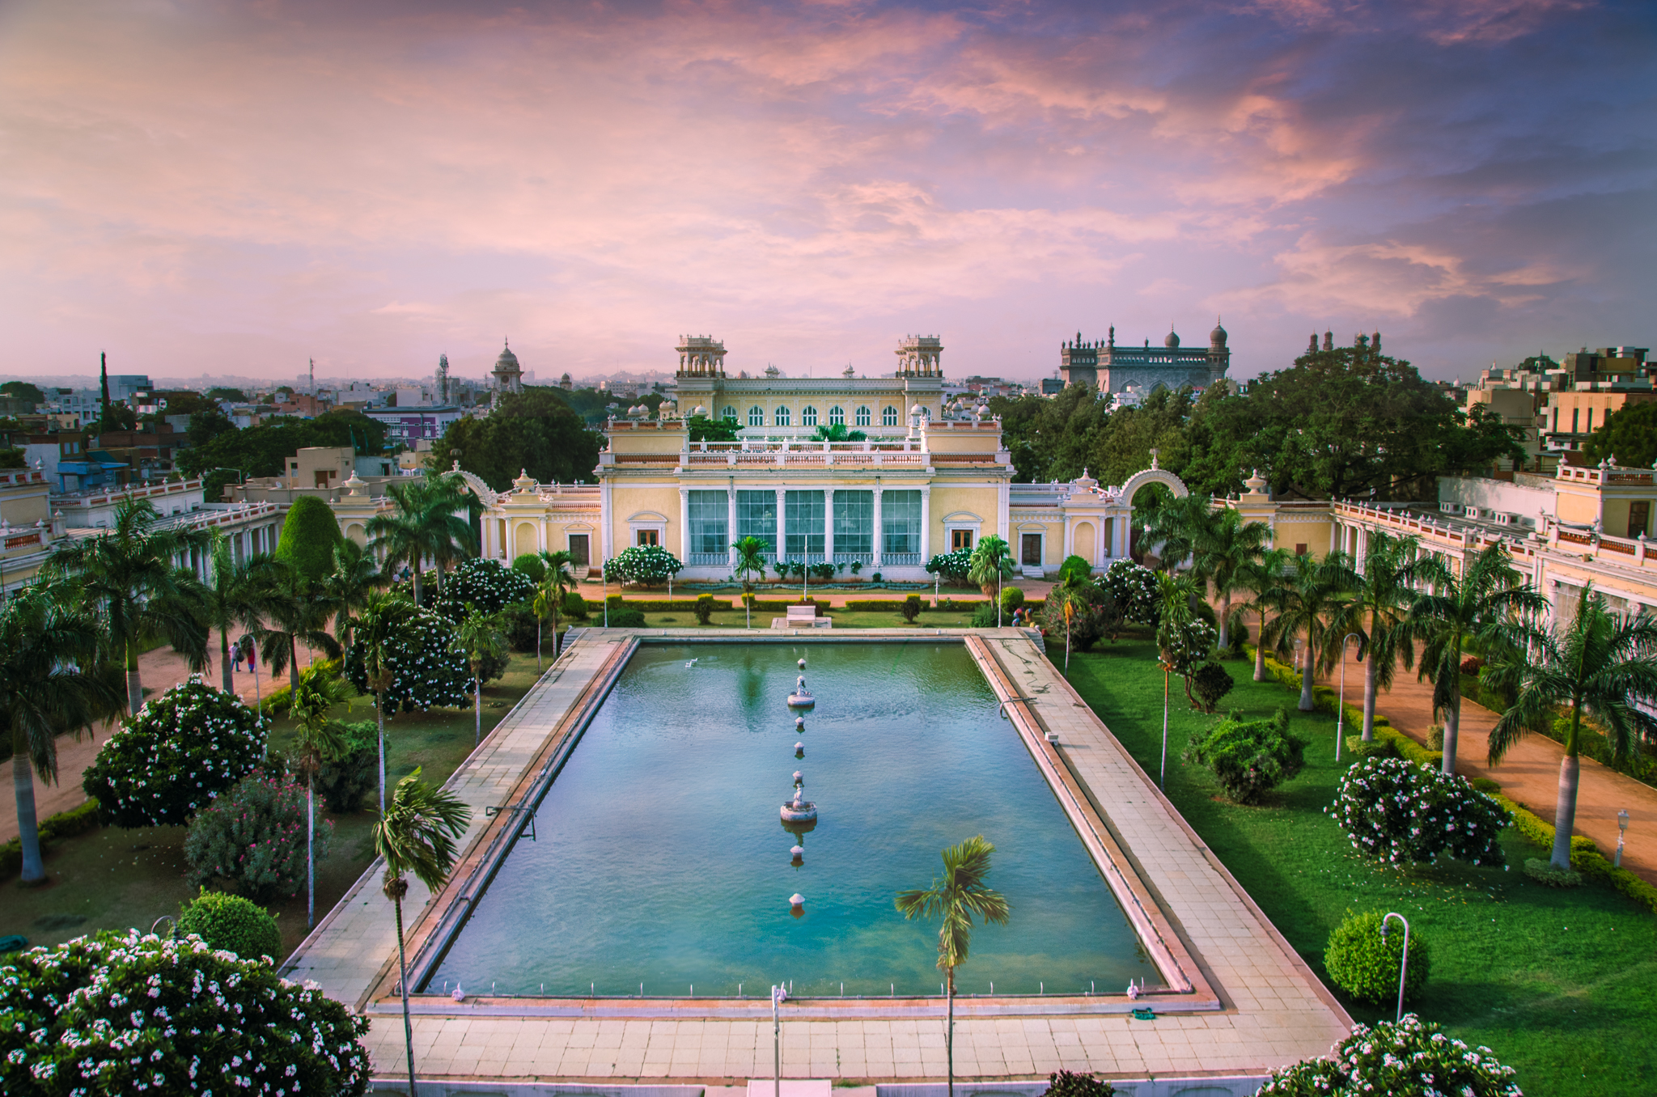
C A S E # 2
The Chowmahalla Palace Museum Shop
Chowmahalla Palace
Hyderabad, Telangana, India

Slide 11
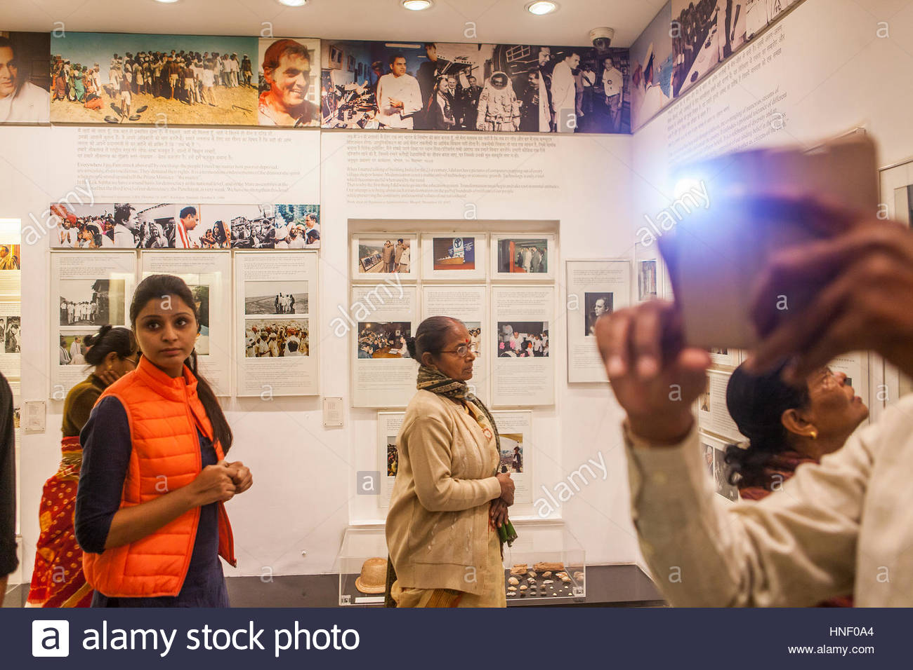
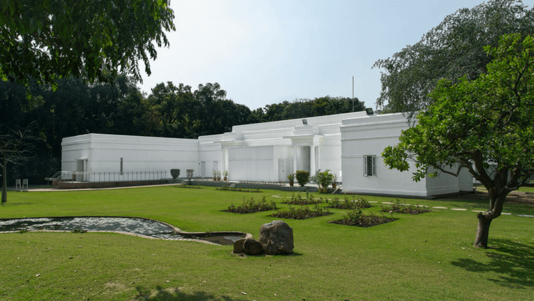
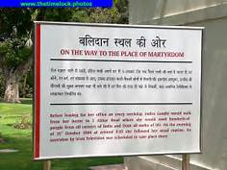
C A S E #3
INDIRA GANDHI
Memorial Trust
New Delhi

Slide 12
Each of these three very different properties presented both challenges and opportunities.

Slide 13
MEHRANGARH FORT, Jodhpur
CHALLENGES:
Lack of any model to follow;
Extremely limited budget;
Unwillingness of good vendors to produce custom items in small quantities we could afford.
OPPORTUNITIES:
A major monument, attracting close to one million visitors a year;
Confidence of our Trustees and their willingness to take a gamble;
Support and advice of international colleagues.

Slide 14
CHOWMAHALLA PALACE, Hyderabad
CHALLENGES:
Bureaucratic/legal complications that delayed progress;
Fairly limited budget;
Visitor profile of mainly moderate income levels; not sure whether they would be good customers.
OPPORTUNITIES:
A very attractive monument, recently restored, beginning to attract attention and visitors;
No comparable products available locally;
Confidence of the Nizam’s family who entrusted the project to us.

Slide 15
INDIRA GANDHI MEMORIAL TRUST,
New Delhi
CHALLENGES:
Walking a thin line between political propaganda and providing a museum-related experience;
Developing products in a site that primarily commemorated a political leader’s martyrdom;
Visitor profile: extremely modest income, primarily from villages and towns throughout India.
OPPORTUNITIES:
3,000 – 4,000 visitors PER DAY, most of whom exhibited strong emotional connection to the family and the events displayed at the museum; all of whom we felt would want to keep a tangible memory of the visit.

Slide 16
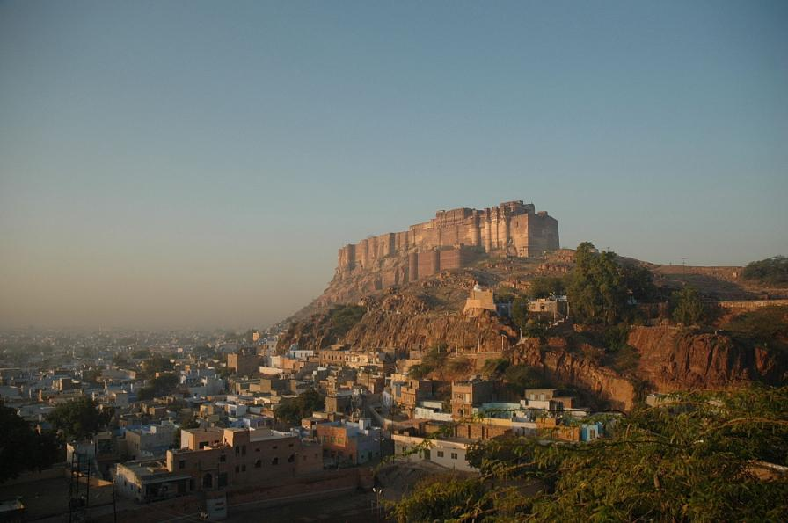
Mehrangarh Museum Shop
Began: 1998
Initial Investment* c . $12,000*
Annual Visitors currently one million plus
Salaried Staff at Opening: 3 untrained youngsters
Salaried Staff, 2019 + 40, highly professional
Contribution to Trust: c. 30% of total revenue
* In US$ equivalent at the time

Slide 17
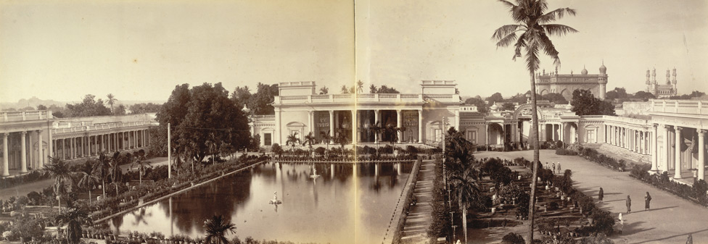
The Chowmahalla Palace Museum Shop
Began: May 2018
Initial Investment* c . $30,000*
Annual Visitors c. 400,000 (3% foreigners)
Salaried Staff 4, untrained, learning fast!
Contribution to Trust: Initial investment repaid within a few months of opening
* In US$ equivalent at the time

Slide 18
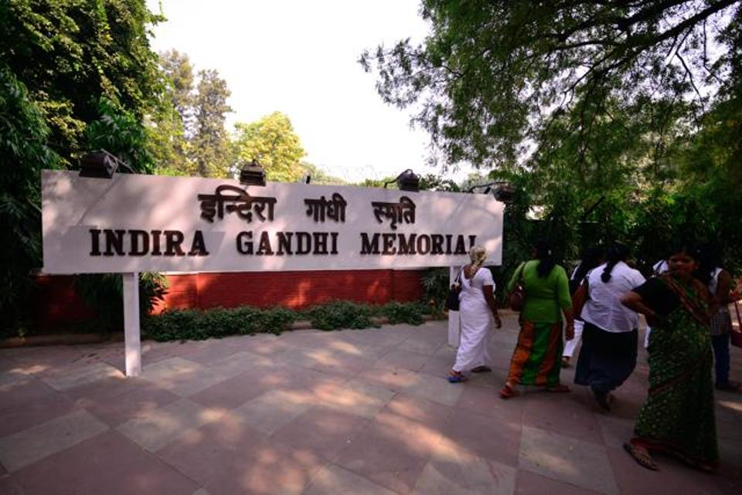
The Indira Gandhi Memorial Trust
Began: 2012
Initial Investment* c . $6,000/*
Annual Visitors + 1 million (primarily rural
and small town visitors on budget tours of India)
Contribution to Trust: We do not manage this shop so are not aware of current financials. However, the shop consistently re-orders large quantities of the original products we developed and produced).
* In US$ equivalent at the time

Slide 19
SO, HOW TO DO IT?
The Essentials:
A committed team (willing to work!)
Committed Trustees
A space, preferably near the exit
A strong logo/image
Product Development
Dedicated staff

Slide 20
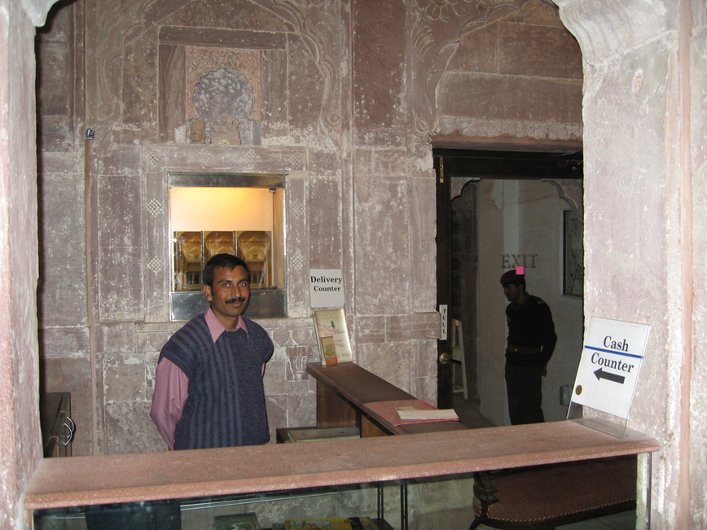
Space can be rudimentary to start. This is the beginning of the Jodhpur shop. With imaginative use of inexpensive materials and good signs, with even a few good products customers will appear.

Slide 21
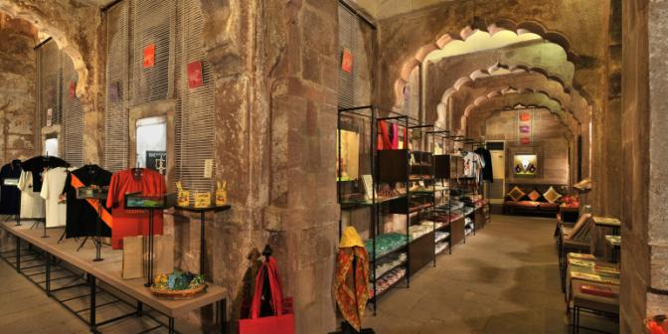
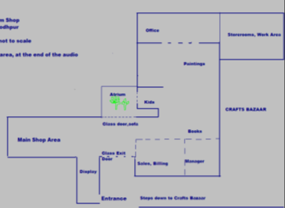
6 years after beginning, we had made enough profit to redesign the space. Results were immediate and dramatic.

Slide 22
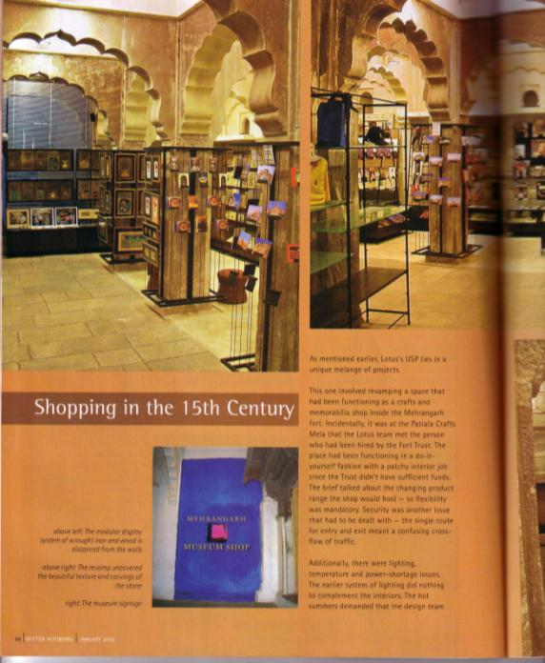
Sales shot up, and we began to attract some serious attention, both in Indian design magazines and internationally as well…

Slide 23
In 2007, in their BEST OF ASIA issue, Time named Mehrangarh the “Best Fortress in Asia”, and added that:
. “The shop could be an annex to New York City’s Museum of Modern Art.”

Slide 24
Over the next few years, we were able to achieve consistent growth, averaging 52% annually.
In 2010, the Trustees,
now confident of long-term viability,
approved a further expansion,
giving us a whole new upper level,
formerly broken into a warren of
administrative offices and cubicles.

Slide 25
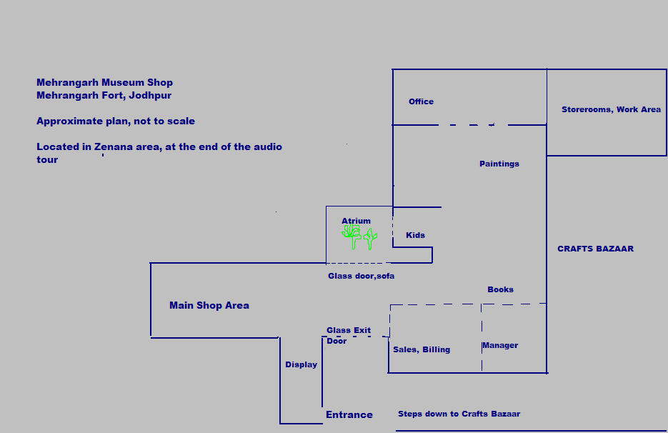
later addition built on
original open terrace
Original Area
NEW SHOP AREA
NEW ADMIN (OFFICES) AREA

Slide 26
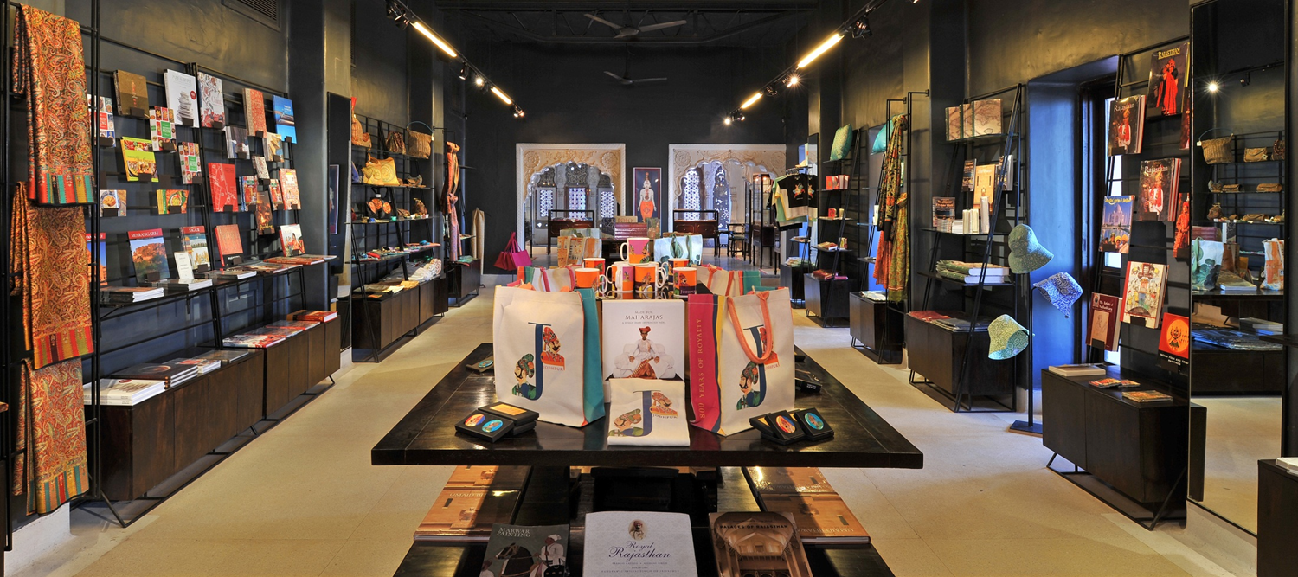

Slide 27

Today the Museum Shop has several “branches” in the Fort, employs a full-time salaried staff of 40, and contributes approximately 30% of the Trust’s full operating budget.

Slide 28
At Chowmahalla, we were able to acquire two rooms formerly earmarked for a canteen. They had not been used for many years, but with the help of our creative
young design team, we were able to transform them.

Slide 29
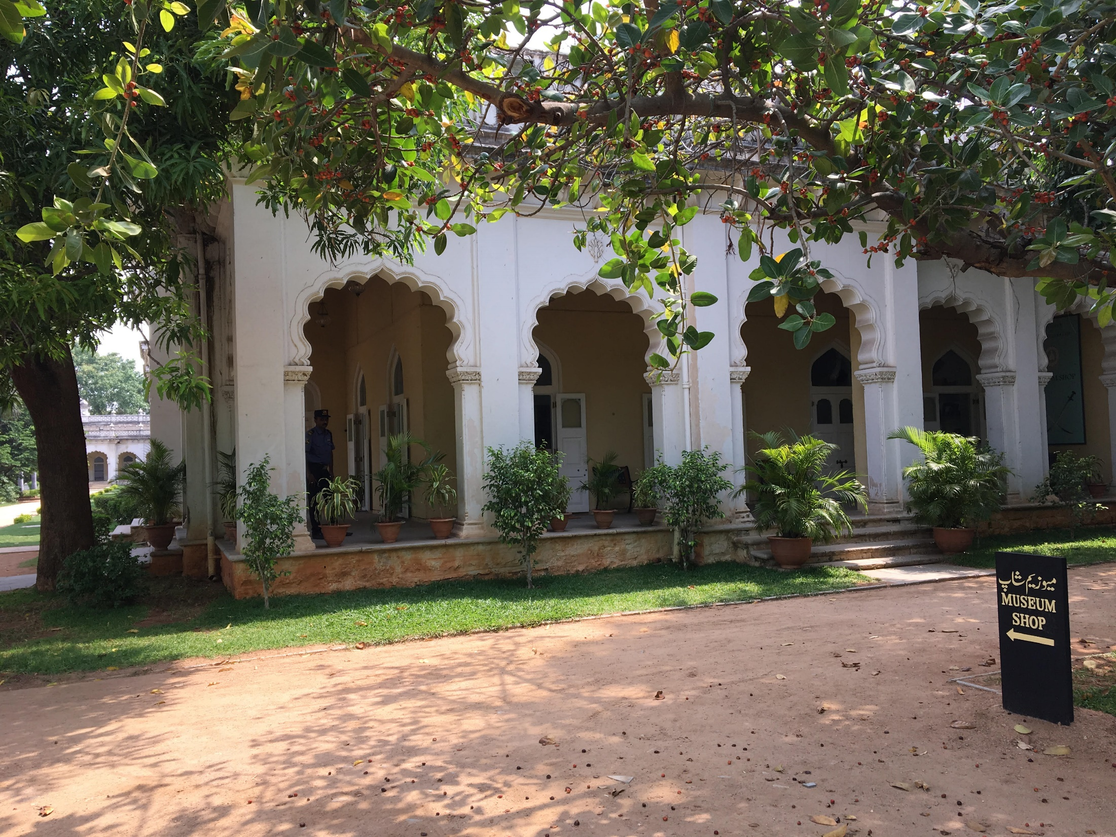
Chowmahalla Shop, Outside Corner

Slide 30
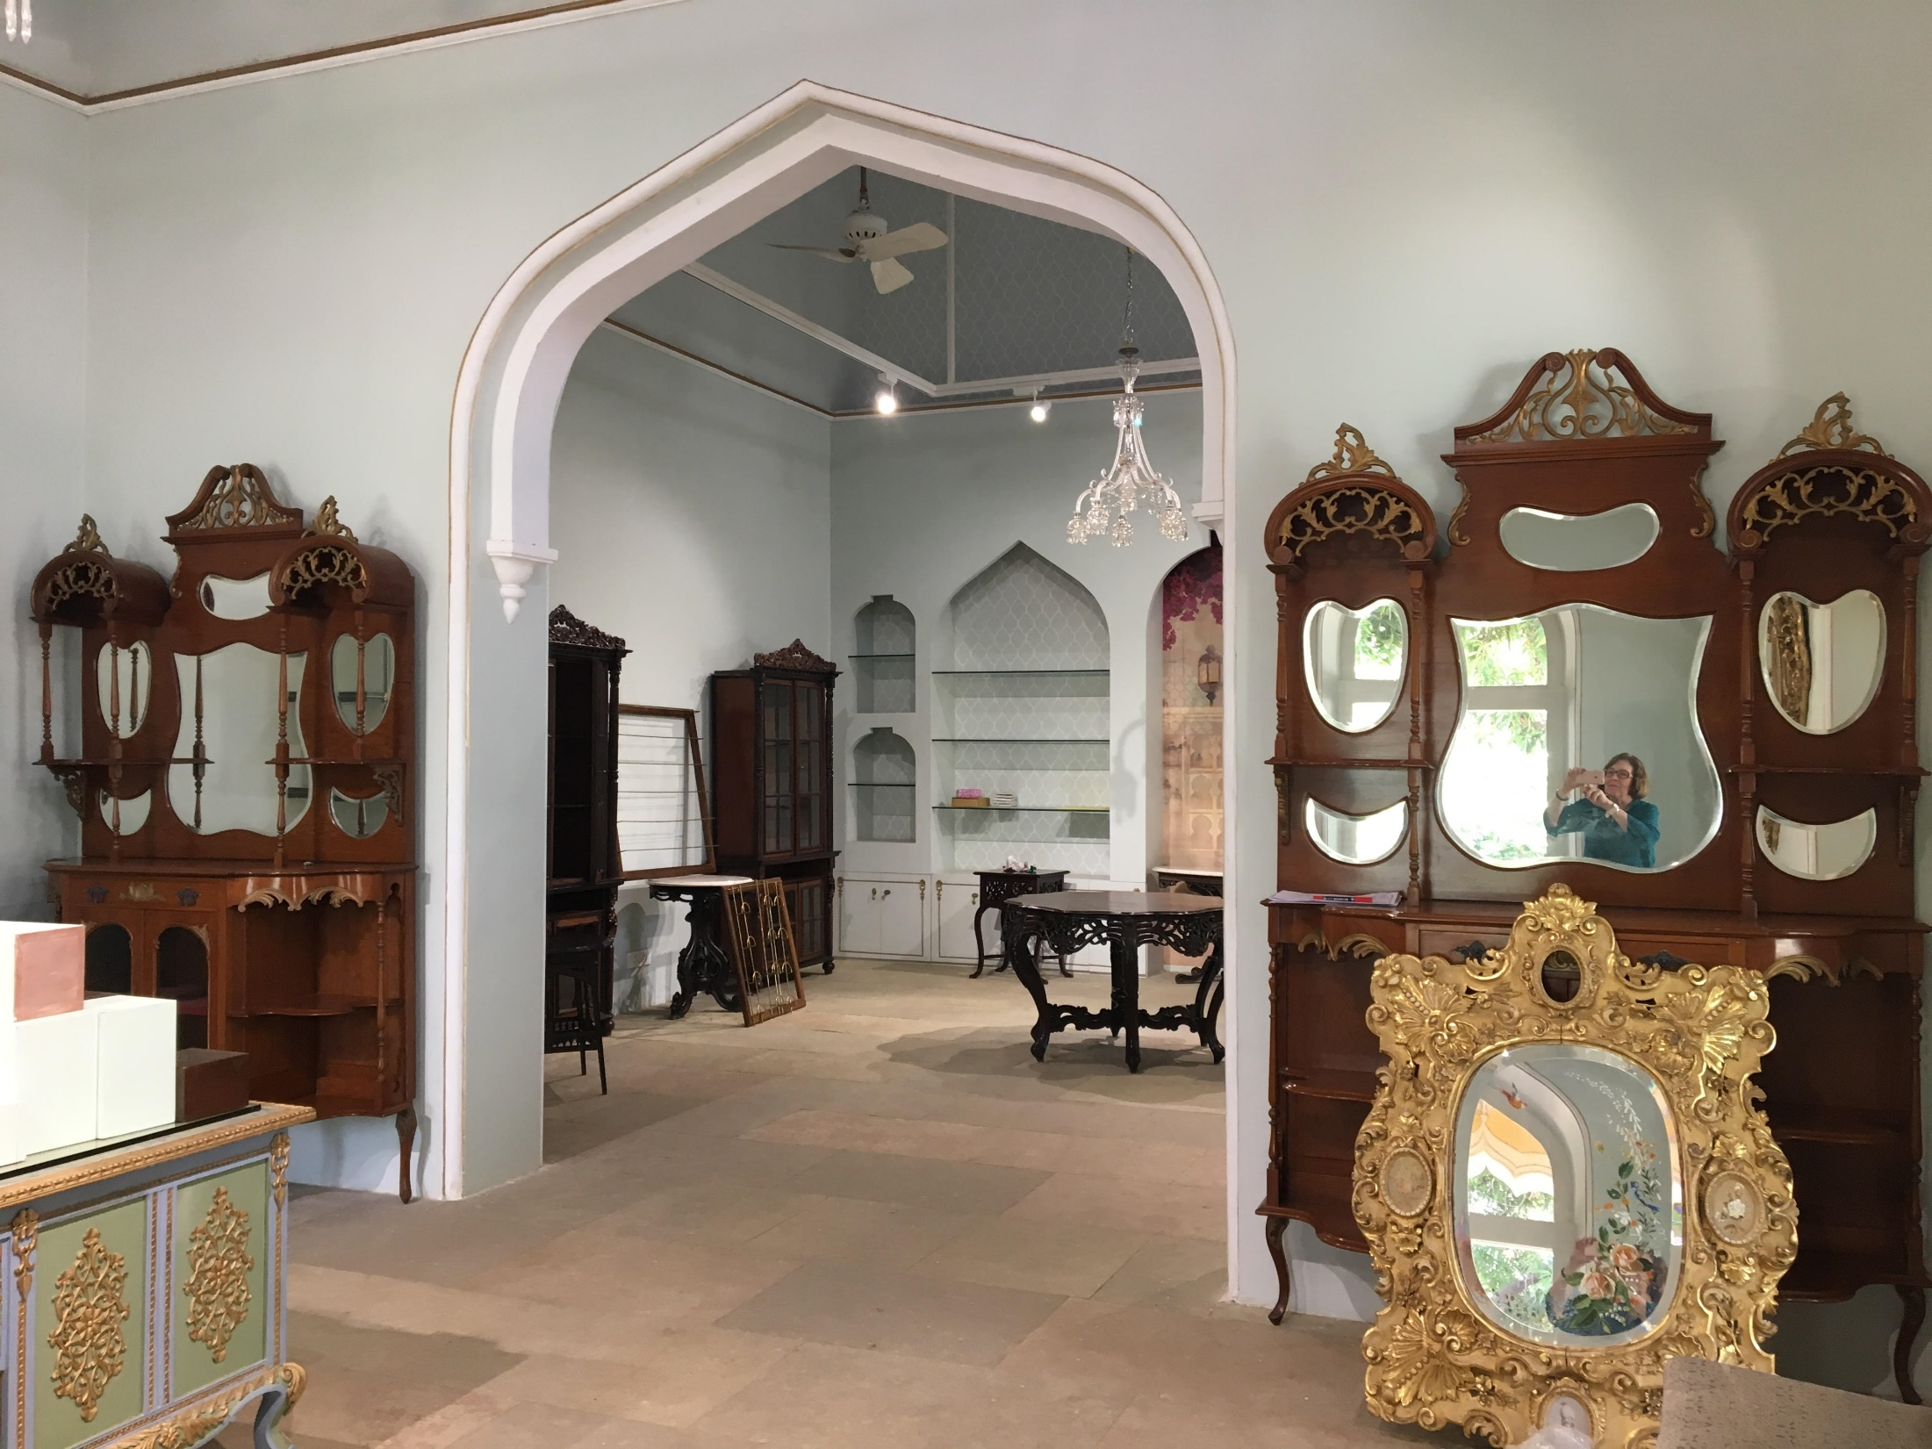
Chowmahalla Shop, transforming two ordinary square rooms by breaking them into one space, with an arched opening that mimics arches found throughout the monument

Slide 31
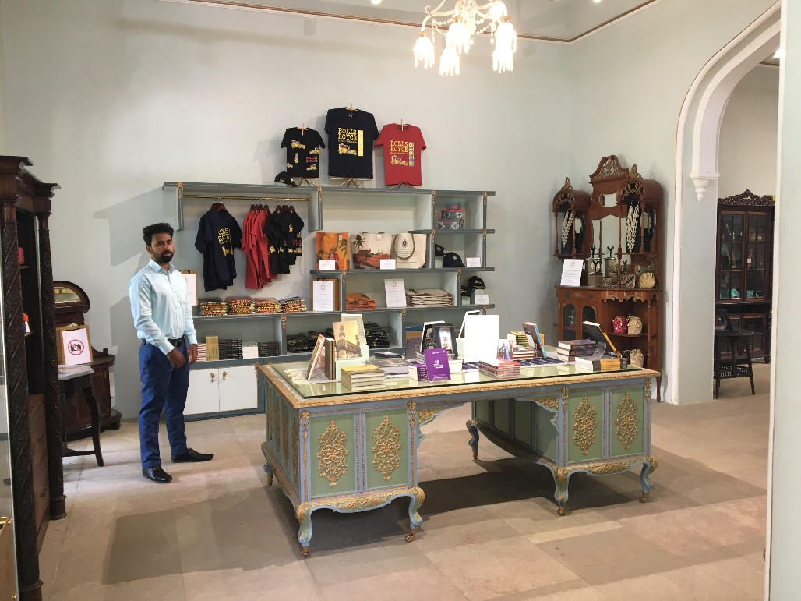
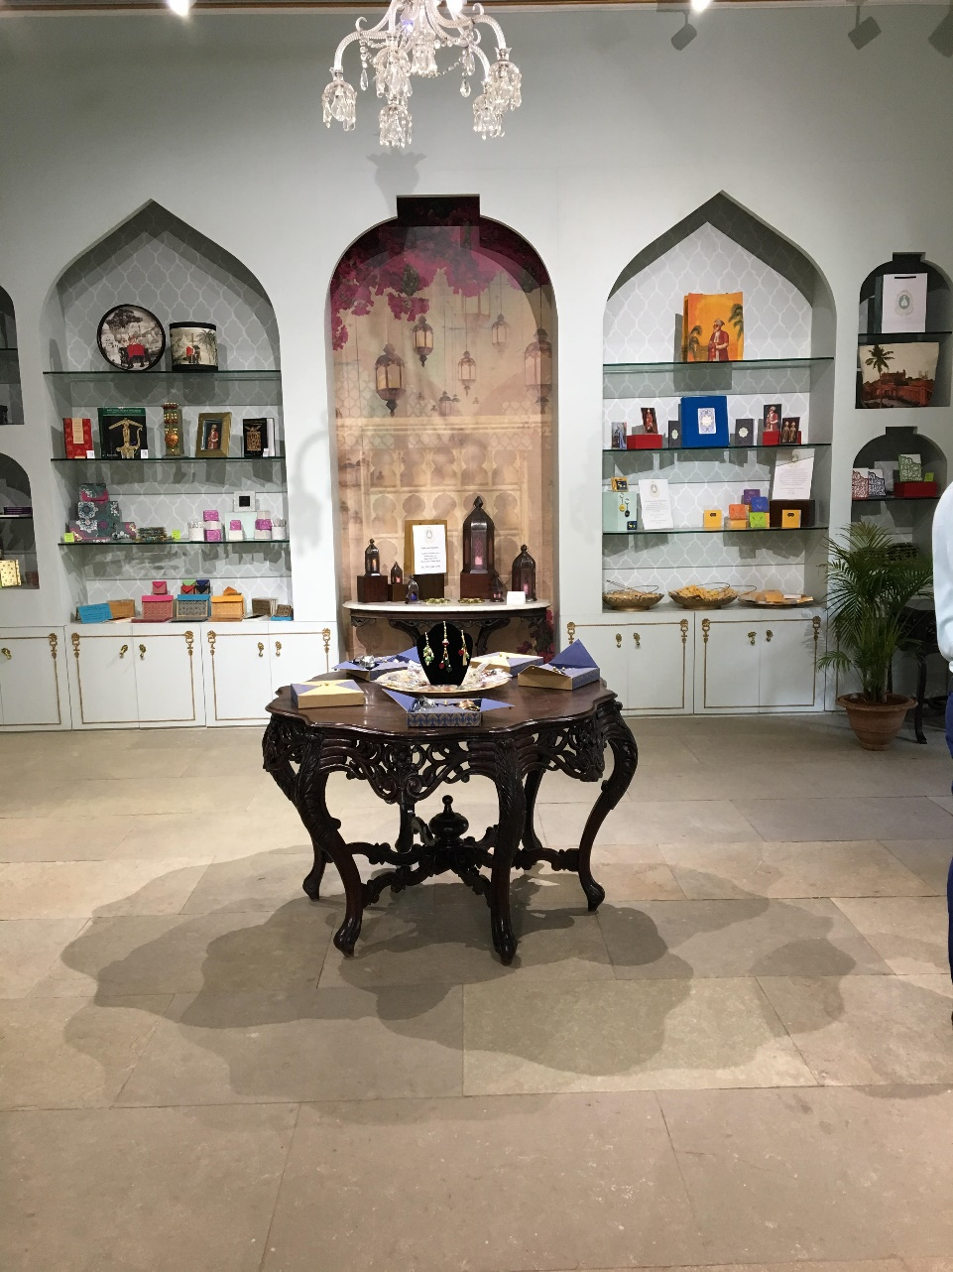
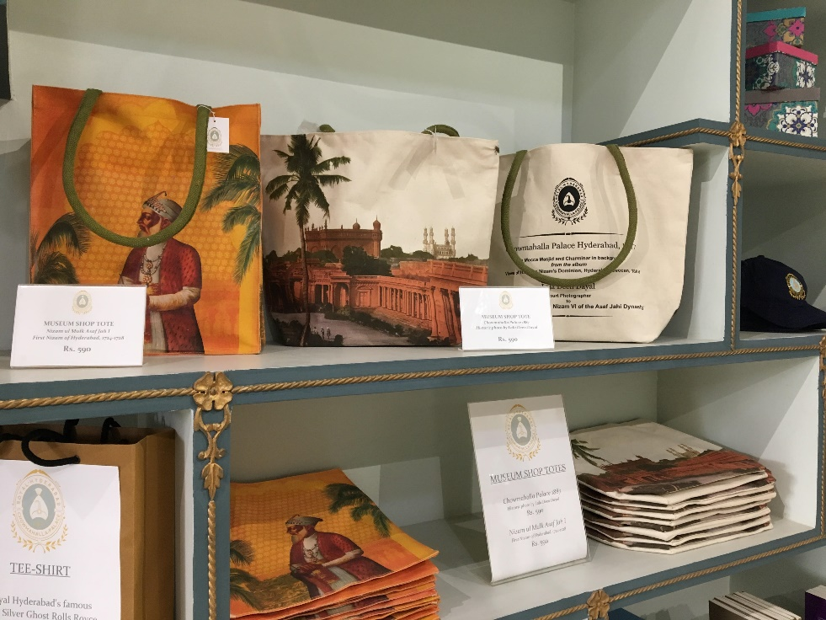
Chowmahalla Interiors

Slide 32
The Indira Gandhi Museum presented a different challenge, as the shop was given a small rectangular outbuilding with no character or visual interest whatsoever. Again, our young design team met the challenge by using the products themselves as the design feature.

Slide 33
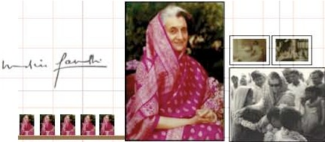

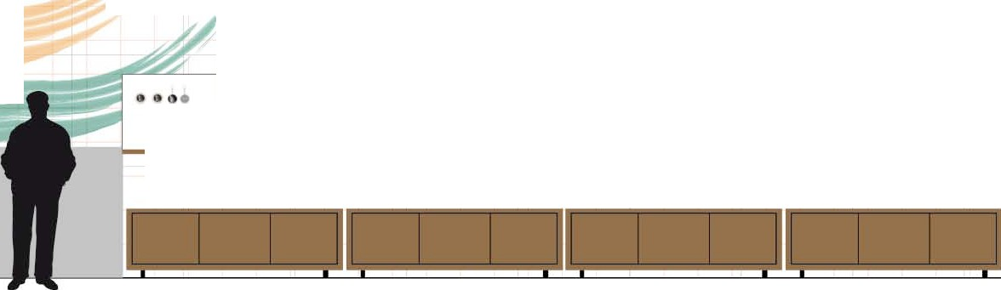

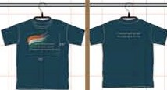
FRONT WALL
(VIEW WHEN ENTERING THE SHOP)
I cannot understand how anyone can be an Indian and not be proud.
Bli$i -;,m Bcf>dl
fcnmc€rll1{ct);q m1TT -rrcf;, m
II
• •
--
---
II 11

Slide 34
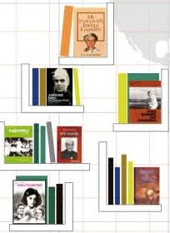
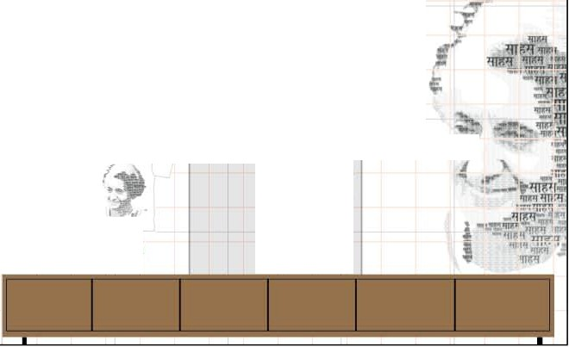



ENTRANCE WALL
( WITH ENTRY DOOR AND WINDOWS)
Ct1ltt1ral Heri tage
The world is my
.!. 1..Jarmony
university
Econo1nic
Prosperit.
(f vereignt} j,_
Courage
National
EtJUc.llity
-
- I.: -.
Wildlife Conservation
Wildli fl!
Conscrvalion

Slide 35
In spite of the great differences between these three sites, once the shop locations were under control, the basic steps in developing their museum shops were the same.

Slide 36
FIRST STEP:
Develop a strong logo/brand image
that relates to the monument or museum.

Slide 37
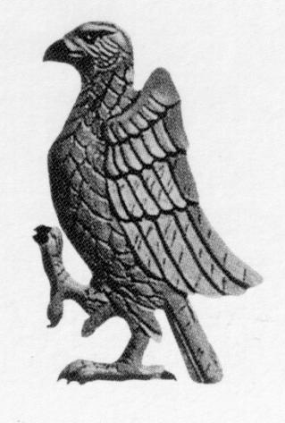
In Jodhpur, this centered on the “cheel”
(pariah kite), a bird with strong historic and symbolic importance in Mehrangarh Fort

Slide 38
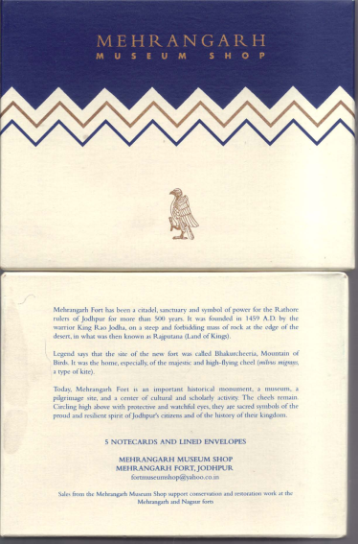
If the logo image is strong enough, and identifies with the institution, it can also be used for product design

Slide 39

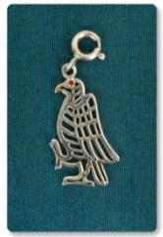
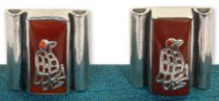
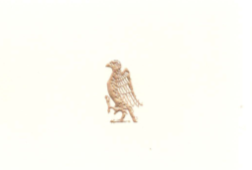
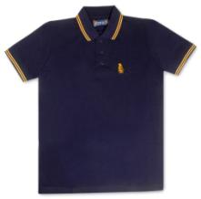
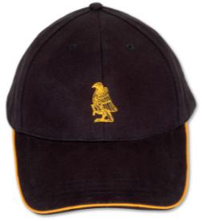


Slide 40

In Chowmahalla, it centered on the “dastar,” a headdress that was strongly associated with the ruling Nizams

Slide 41
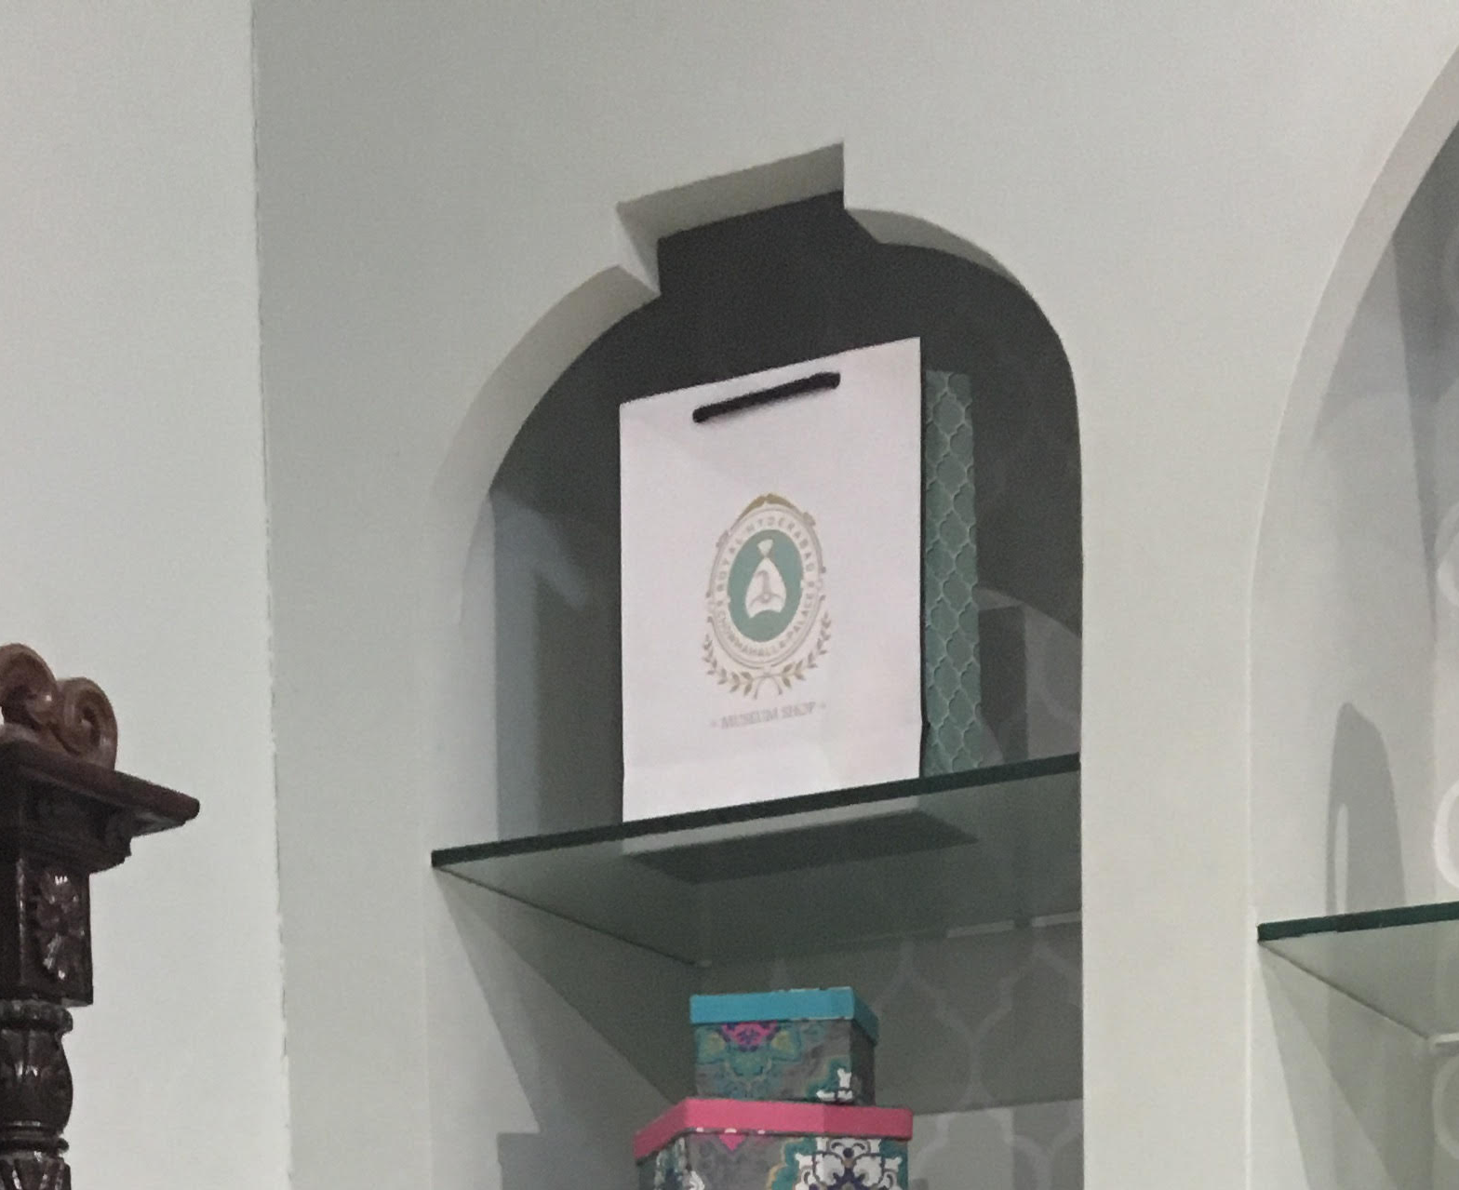

Slide 42
Second Step:
Product Development
Most viable products to begin with:
Postcards / Books
Tee-shirts / Caps
Tote Bags

Slide 43
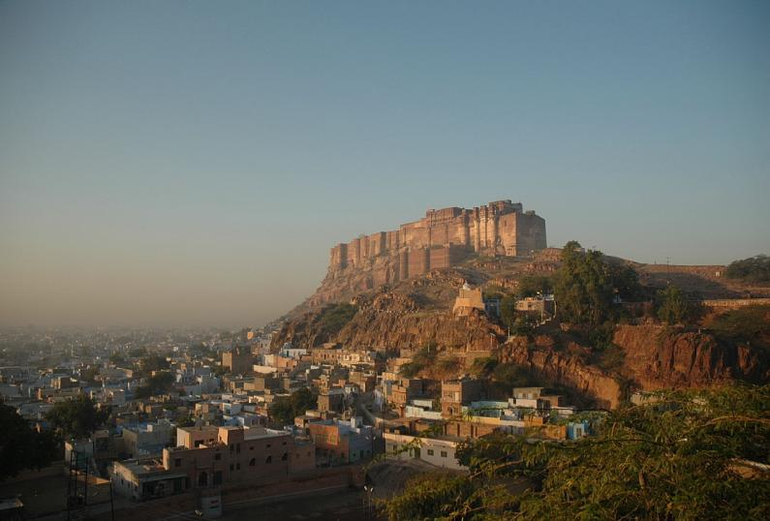
Basic Resources: The Monument
Mehrangarh Fort, Jodhpur
1459 AD

Slide 44
Other Resources Useful in Jodhpur:
Museum Collections
Royal Family
Jodhpur Polo Team
Jodhpur / Rajasthan History
Rajasthani Crafts
Aspects of Contemporary India
(Bollywood; Auto-rickshaws; Tea)

Slide 45
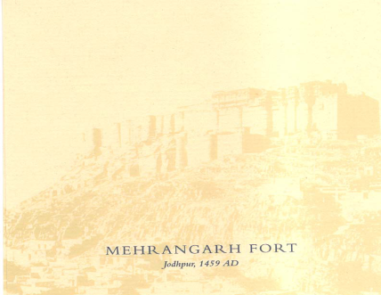
Softening the Image
worked for:
Notecubes, Notepaper, Watches
Importance of Tag Line: 1459 A.D.

Slide 46
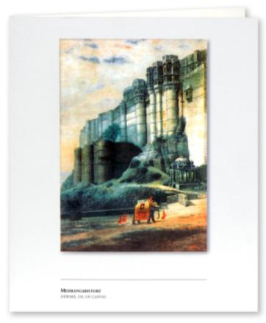
Romancing the Image
worked for:
Greeting cards
Mousepads
Tee-shirts

Slide 47
Playing with the Image
The Lion’s Head Dagger
became the focus of
one of our best-selling
products:
JODHPUR ON THE EDGE
Tee shirts

Slide 48
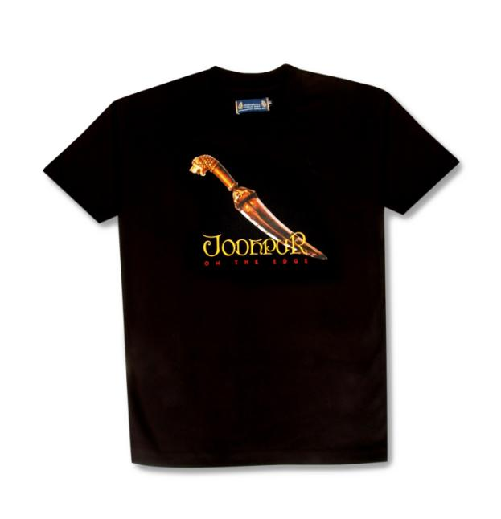

Slide 49
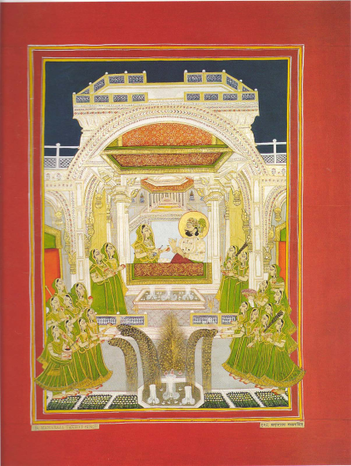
Linking the Image
Painting of a
19th century Maharaja celebrating Diwali, a festival that still involves good-natured card games and gambling.
Products:
Playing Cards
Greeting Cards
Tee-shirts

Slide 50
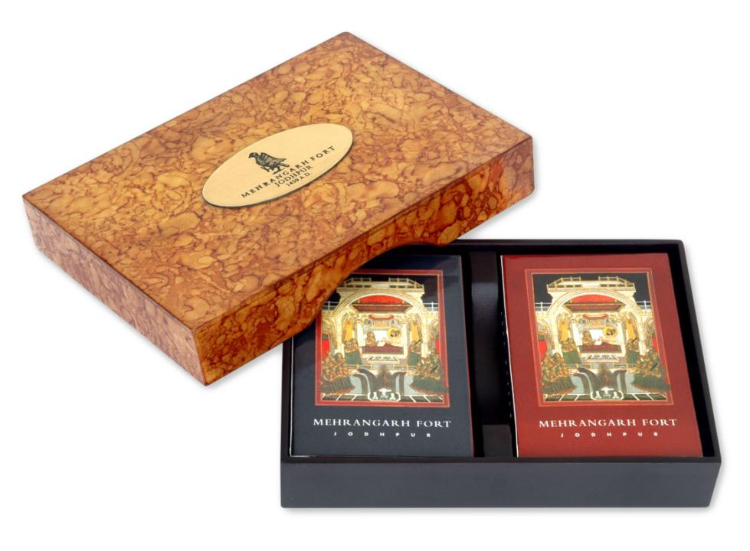

Slide 51
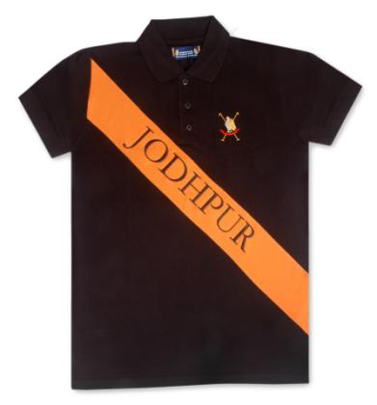
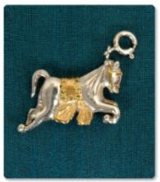
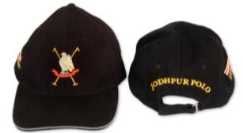
Resource:
Jodhpur Polo Team

Slide 52
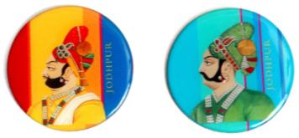
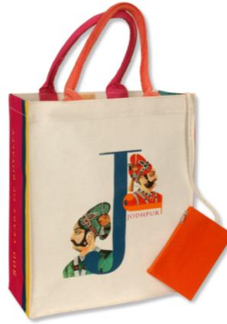


Resource: Jodhpur Royalty

Slide 53


Resource: Exhibitions

Slide 54




Slide 55
In Chowmahalla, the collections and the monument presented a more limited range of options. One of the most popular objects in the palace is a 1912 bright yellow Rolls Royce. This thus became a focus of what proved to be extremely popular products.

Slide 56





Slide 57
Other sources for the initial product line were an impressive collection of swords, images of the early Nizams, and a beautiful 19th century Deen Dayal photograph of the monument itself.

Slide 58



Slide 59




Slide 60


Slide 61
For the
INDIRA GANDHI MEMORIAL MUSEUM project, we avoided a political tightrope by concentrating on a few quotes of Mrs. Gandhi’s, and on an image of her.
Since visitors to this museum come (by the busload!) from all corners of India, all products were done in several languages, in addition to English.

Slide 62
Based on Quote:
“I Cannot Understand how Anyone Can be Indian and Not be Proud.”

Slide 63
Based on Quote:
“The World is My University”
(an entire line of products for school children was based on this quote)

Slide 64

Products using an image of
Mrs. Gandhi, interspersed with words of traits or issues with which she is identified.

Slide 65
In all projects the basic guidelines to which we adhere:
Authenticity
(of image, material, experience)
Finest Quality, Fairest Prices
Made in India

Slide 66
We also work for community involvement, through:
Products produced by NGOs and traditional craftspersons;
Employment policies, especially providing opportunity and training to women and local youngsters.

Slide 67

Crafts Bazaar

Slide 68



Products by Local NGOs

Slide 69
POSITIVE OUTCOMES
of
ALL PROJECTS:
Revenue Generation
(financial stability)
Visitor Satisfaction
Employment Generation

Slide 70

For more information on the Jodhpur shop, Please visit us:
www.mehrangarhmuseumshop.com
Or visit us in India anytime – we would love to show you our shops, and of course our sites.

Slide 71
If you are thinking of taking the plunge, we’ve put together some detailed advice. Email us, subject
“MUSEUM SHOP MANUAL”
and we will send you the Dropbox Link
Email: museindia@yahoo.co.in
Maureen Liebl, Amrita Singh
Muse India Heritage Concepts Pvt. Ltd.
Curating Cultural Commerce
museindia@yahoo.co.in

Slide 72

Thanks! !

