Slide 1


New meaning to old values
Practitioners in Partnership:
Sharing best practice across the INTO network
London, 5.11.2018
Dr Irena Edwards, Chairman

Slide 2
Journey to establishment
Founded 2013 in Kromeriz, Moravia – to fulfill a need
Launched in London June 2014 – a flying start
Reasons why CNT was founded
Main Aims and Mission
CNTA , London founded 2015 supports and fundraises internationally
Launch of pilot project in Moravia, June 2016
Prague Group from end 2016
INTO gives protection and credibility, shares know how & networks

Slide 3
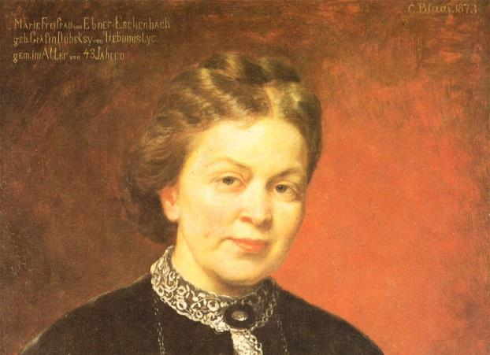
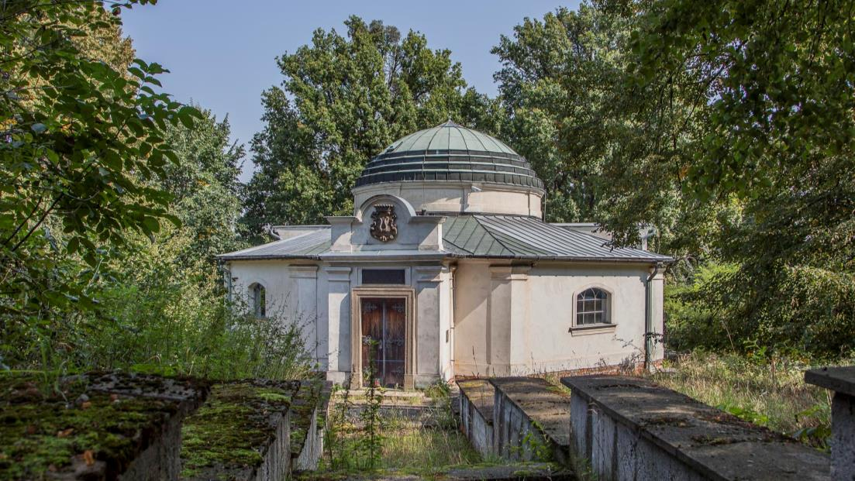
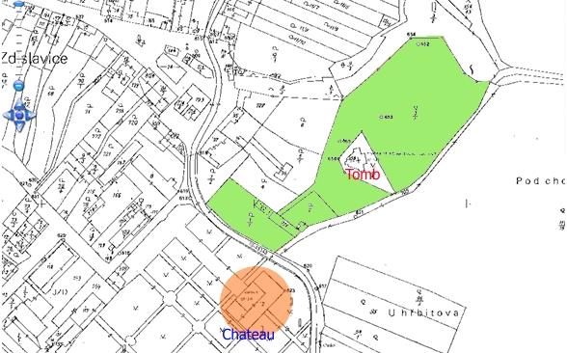
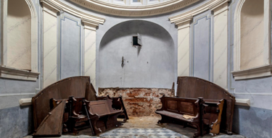
    Inspirational Pilot Project

Slide 4
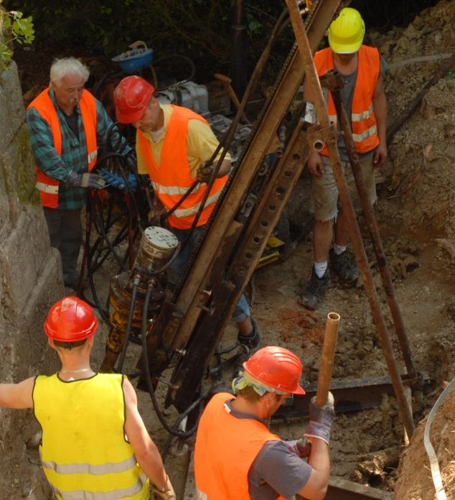
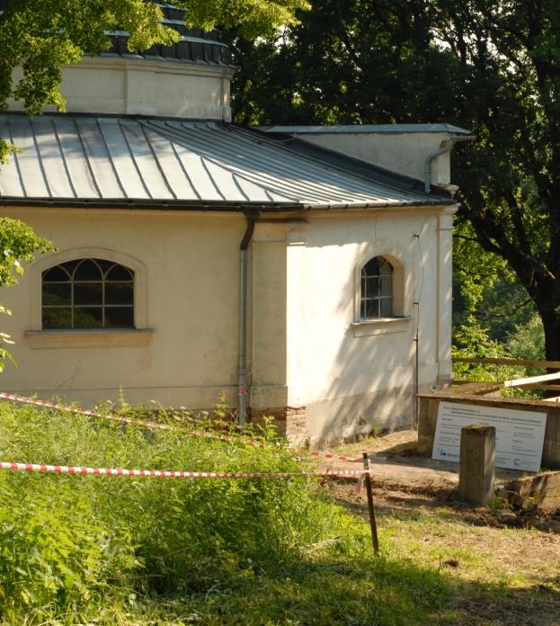
    Inspirational Pilot Project

Slide 5
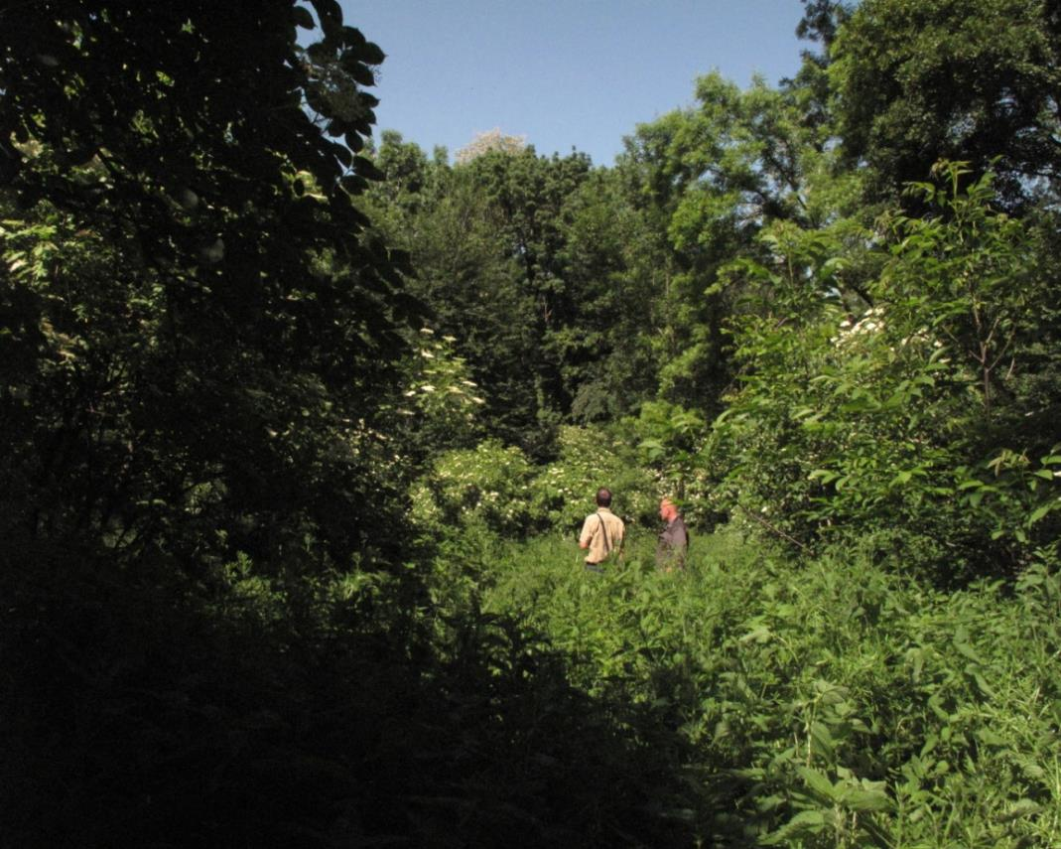
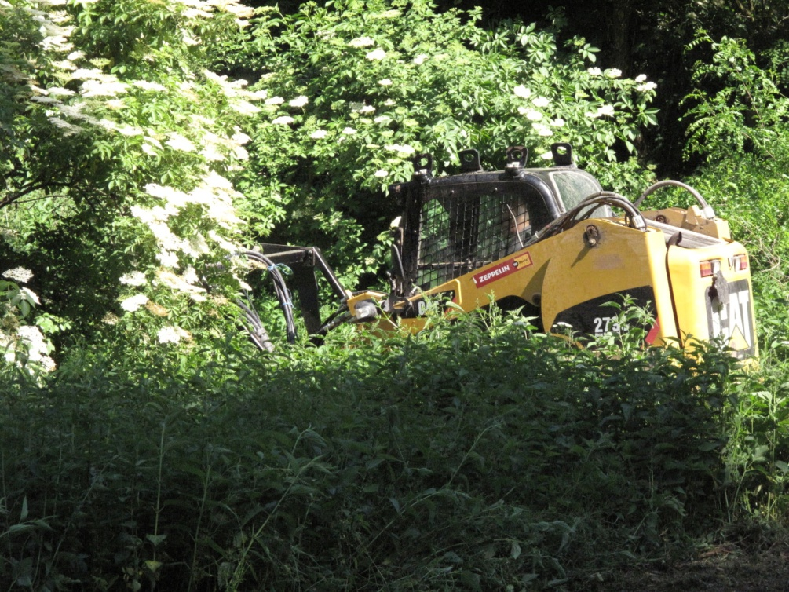
    Land Clearance May 2015 – after 50 years of neglect!

Slide 6
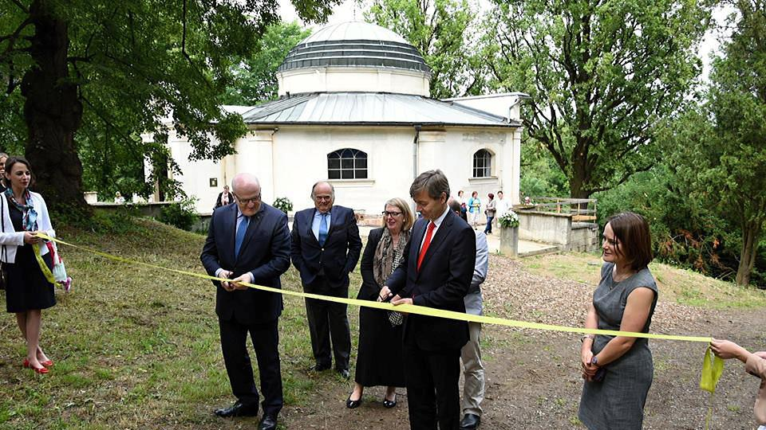
Notes:
Slide: Photo with Herman etc. cutting ribbon in Zdislavice
On the slide you see us opening our pilot project in Zdislavice…

Slide 7
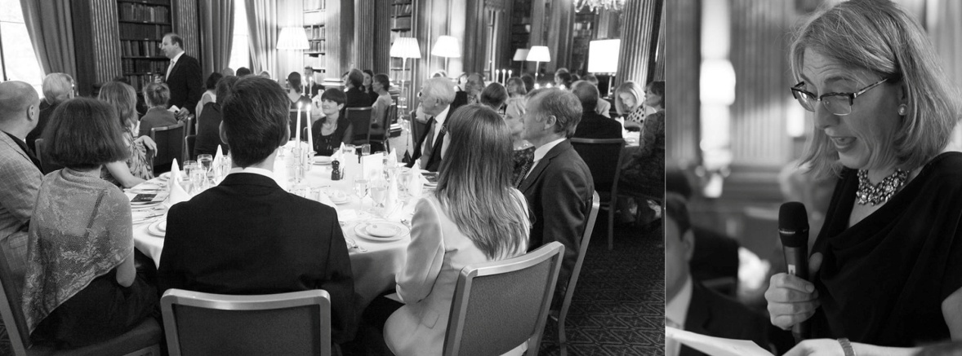
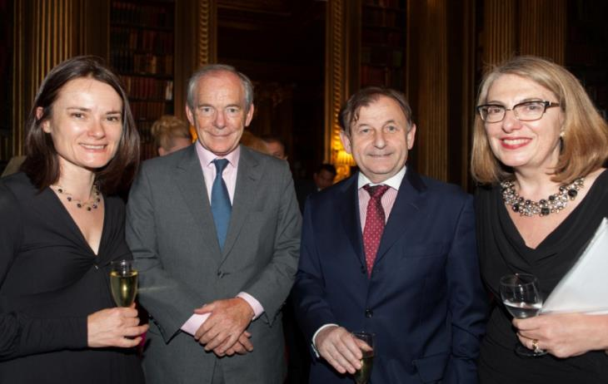
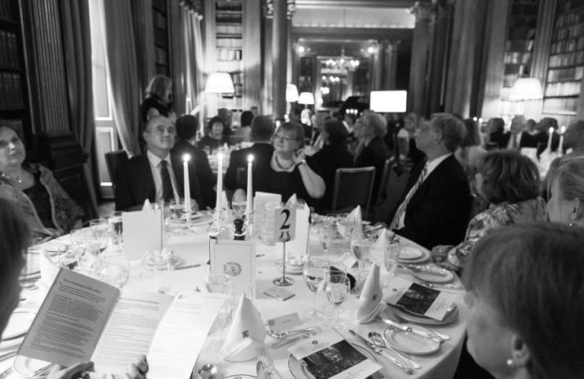
CNT Launch 2014:
Flying start in the Reform Club, London
    £ 21,000 raised
    towards pilot project
Notes:
Slide: Launch of the Reform Club
CNT was actually launched in London, in the Reform Club…

Slide 8
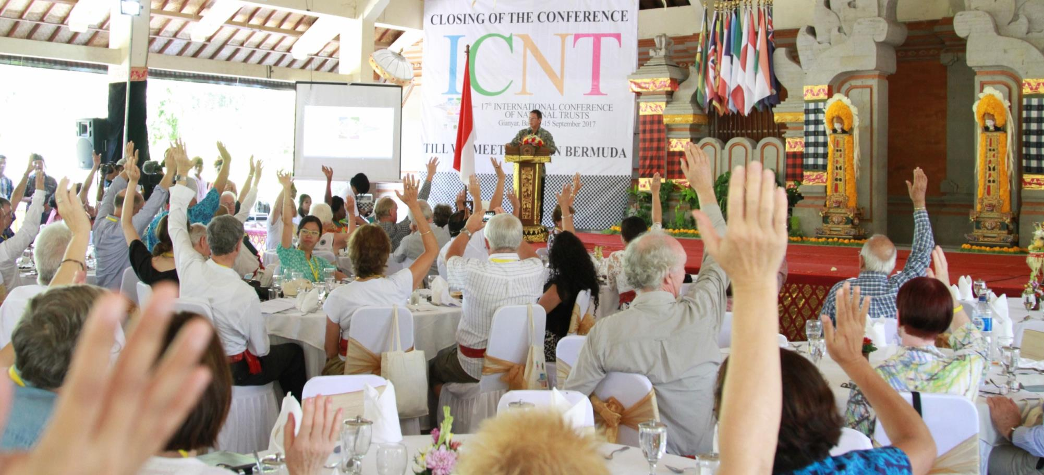
The role of INTO and NT

Slide 9
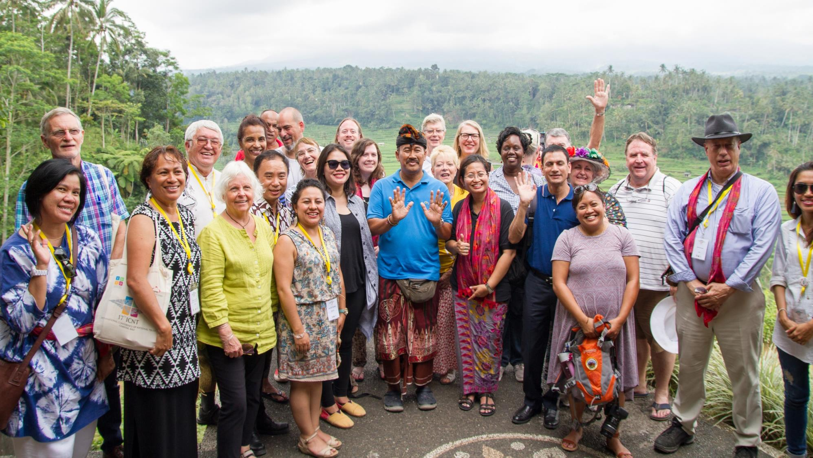
Notes:
Slide: BALI
The biannual International Conference of National Trusts remains at the heart of the NT movement ….

Slide 10
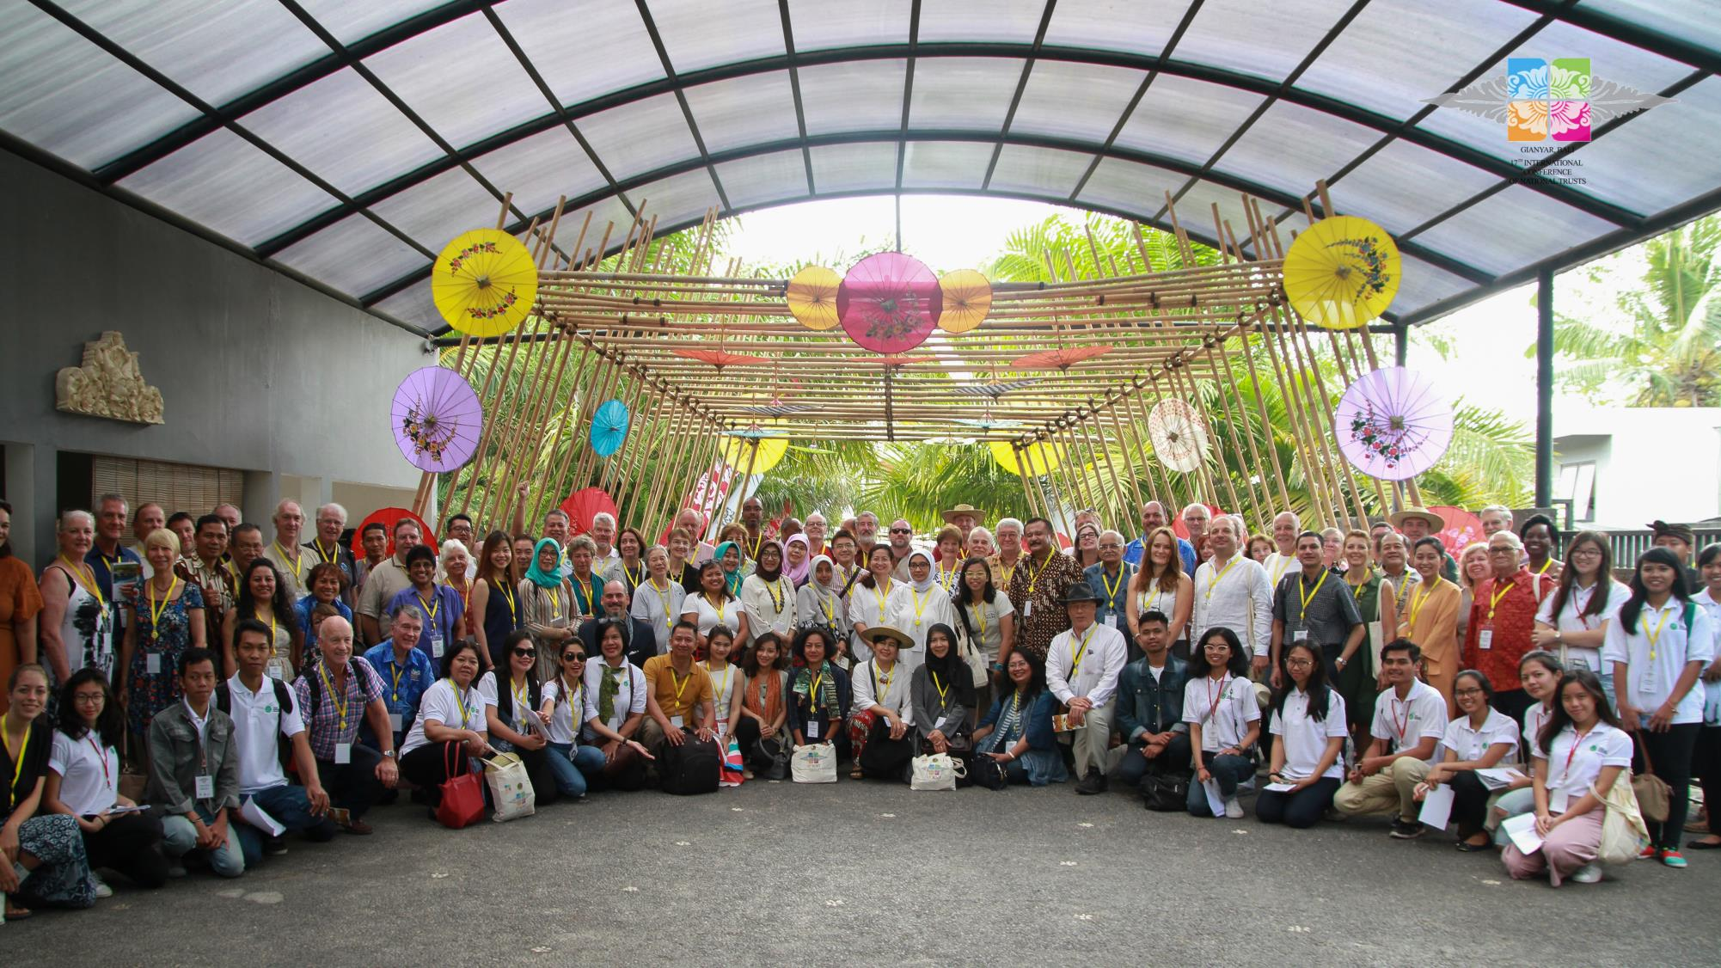
Notes:
SLIDE: BALI line up
The conference was in Bali where there were over 120 delegates ….

Slide 11
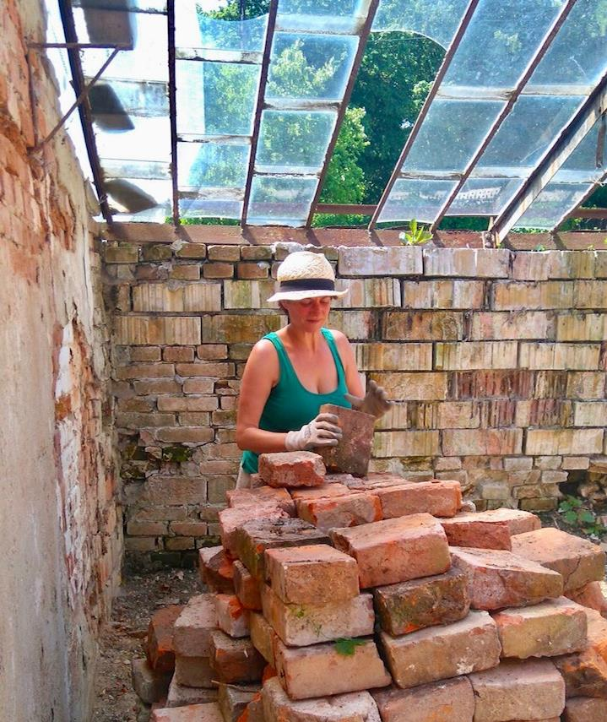
Working holidays and team building
      2-3 working holiday weeks annually since 2016 on Pilot project site – Zdislavice, Prague, this year expanding to other sites
      Corporate team building weekends

Slide 12
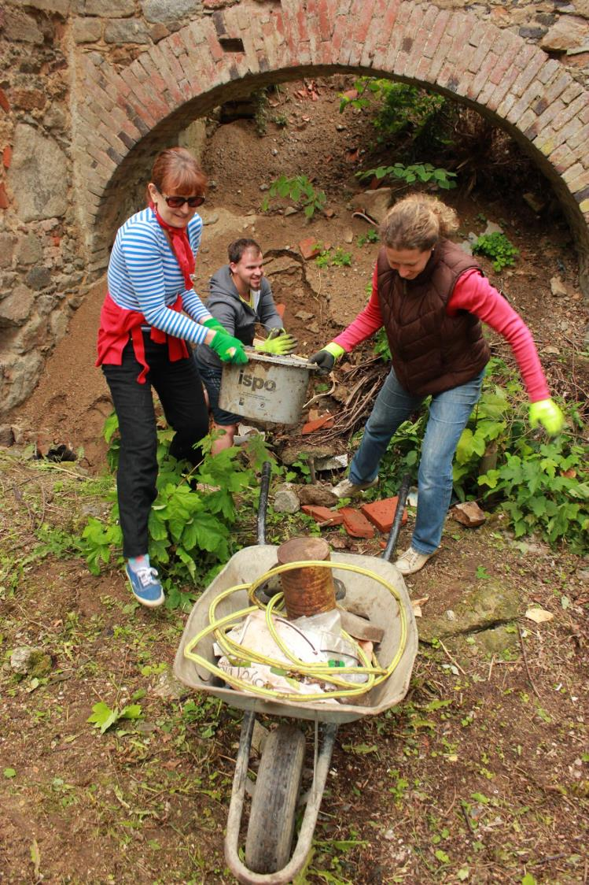
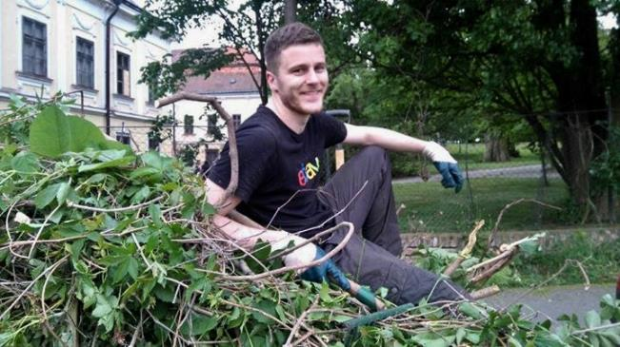
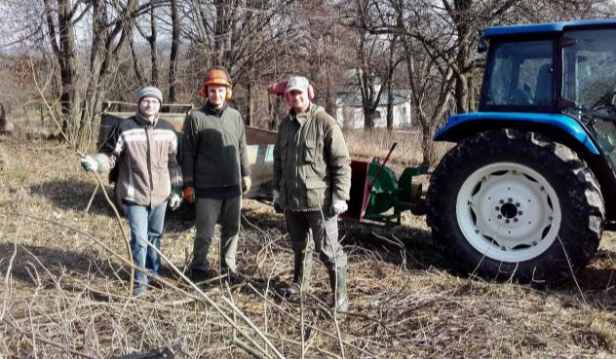
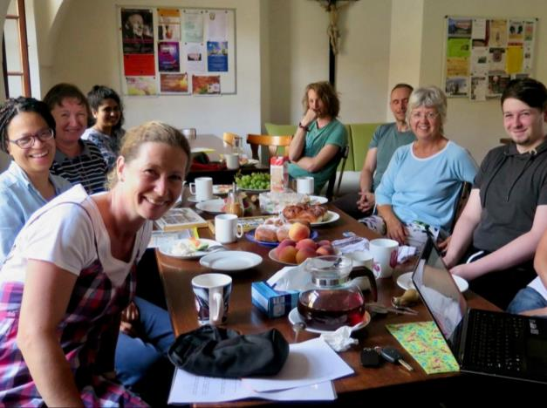
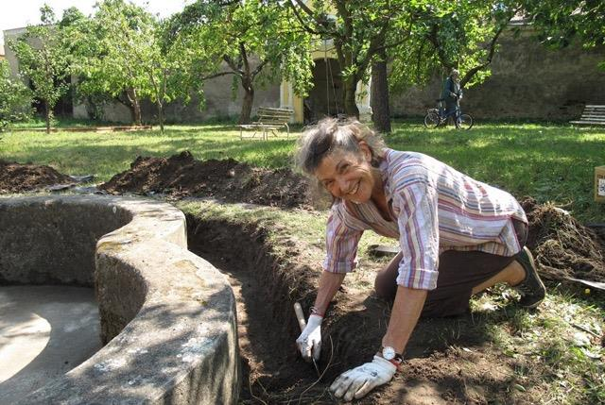
Working holidays cont’d

Slide 13
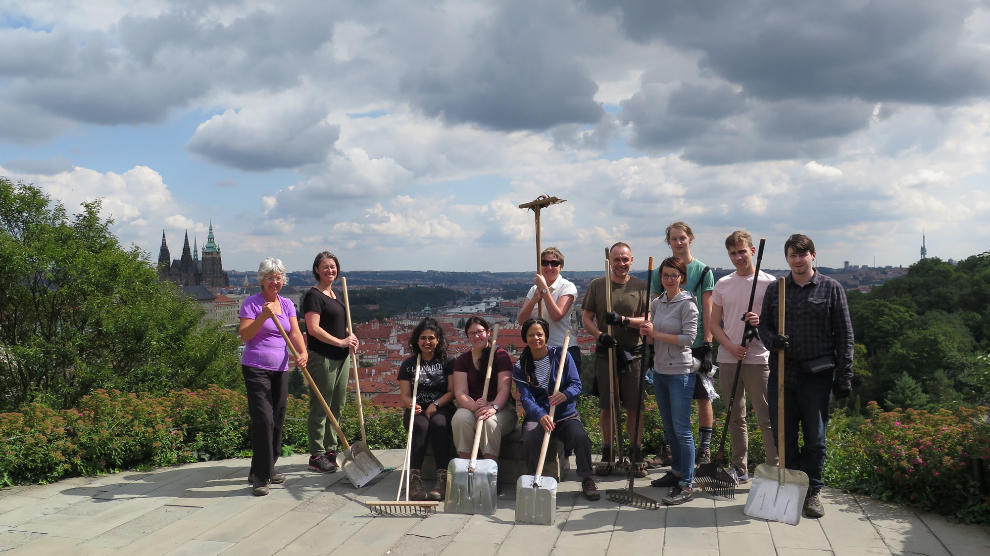
Notes:
SLIDE: talk to CNT briefly (additional slide)

Slide 14
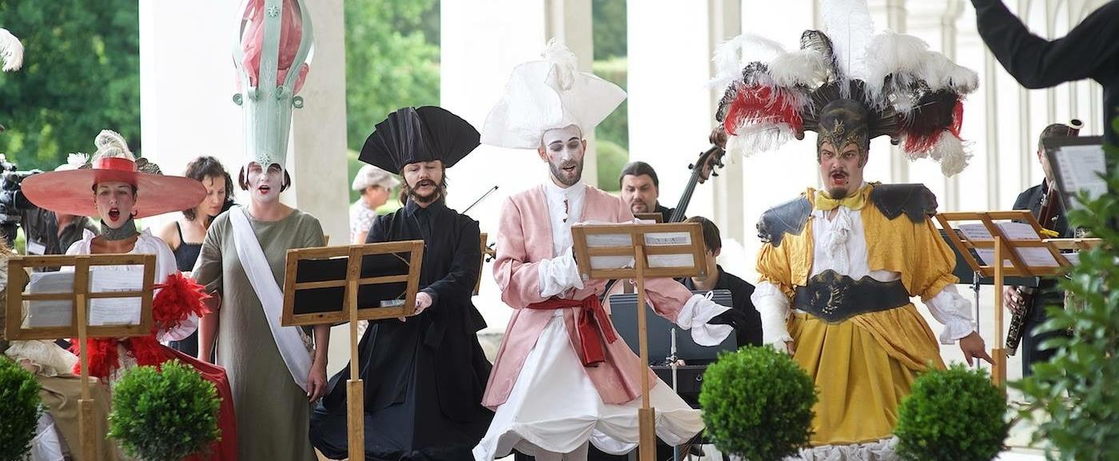
    Baroque Festival in Moravia

Slide 15
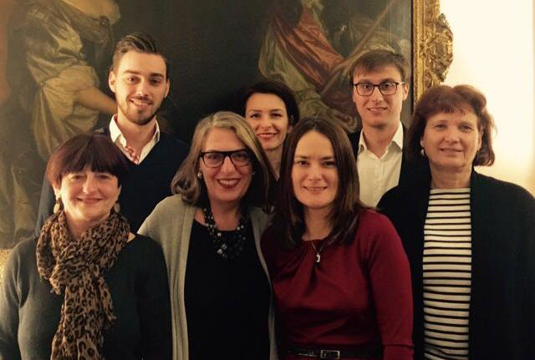
CNTA Czech National Trust Abroad - CNTA
Registered Charity in England and Wales No.1162843
Independent organisation based in London
Raising funds and supporting CNT in UK and internationally
    Patrons and advisors:
    Baroness Kay Andrews , Alastair Laing,
    Dr Jose Hlavnicka, Irena Murray-Zantovska, Richard Bassett
    Trustees:
    Irena Edwards, Catherine Leonard, Michael De Val , Zuzana Princova
    Executive Board:
    Trustees, Zuzana Princova, Eva Bonfield,
    Petr + Martin Krpata

Slide 16
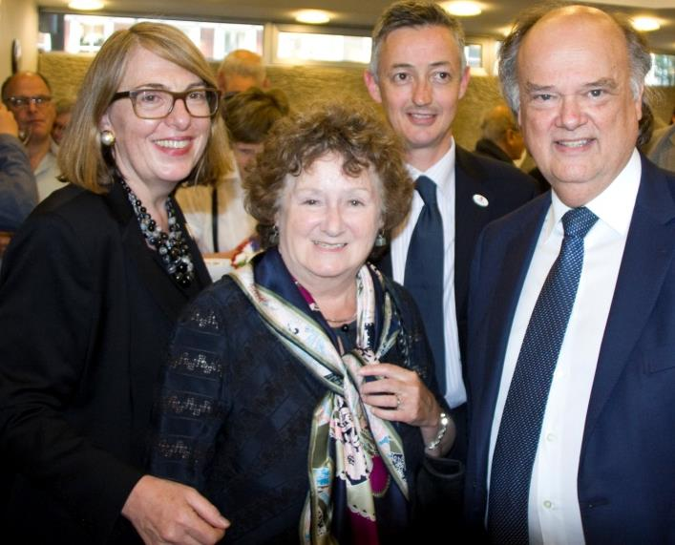
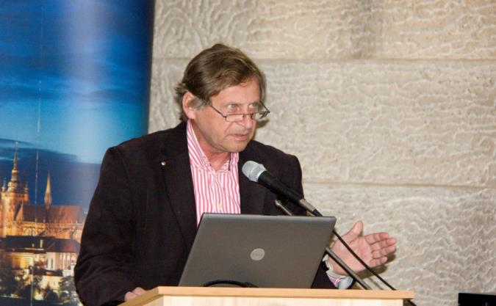
CNTA annual special events
    Celebrating 1st Anniversary of Czech National Trust June 2015
    Czech Embassy in London
    Presentation of pilot project
    CNTA announcement
    Lecture: Prof. Zdenek Lukes
    leading Czech historian of architecture

Slide 17
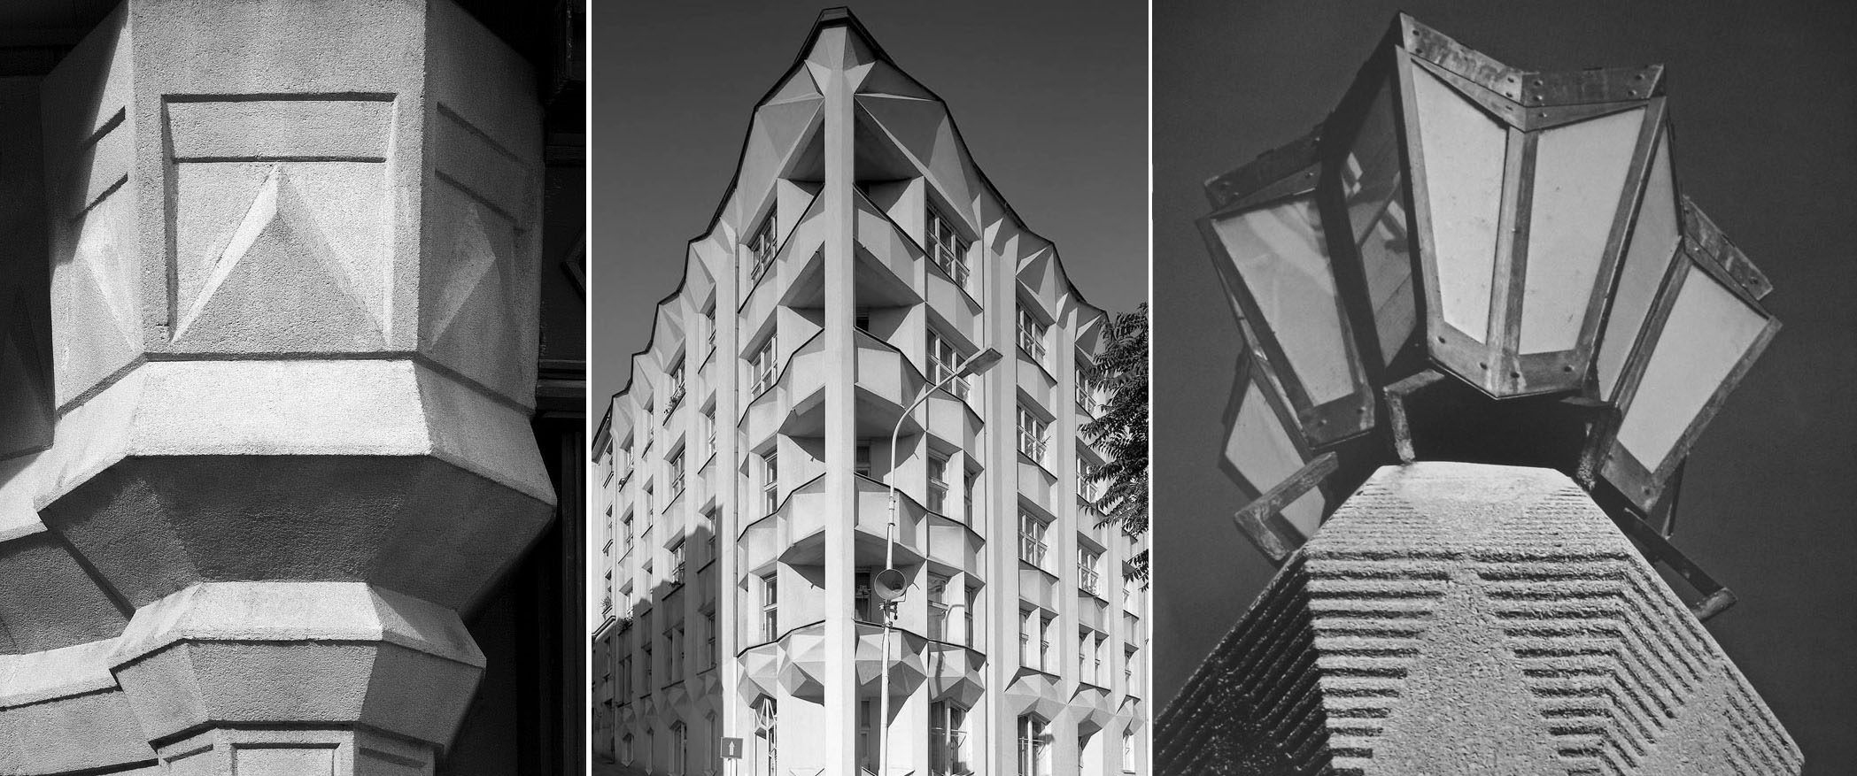
CNTA annual special events
Celebrating 3rd Anniversary of Czech National Trust, London June 2017
Presenting Czech Architectural Cubism by Prof. Architect Zdeněk Lukeš

Slide 18
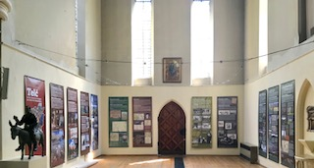
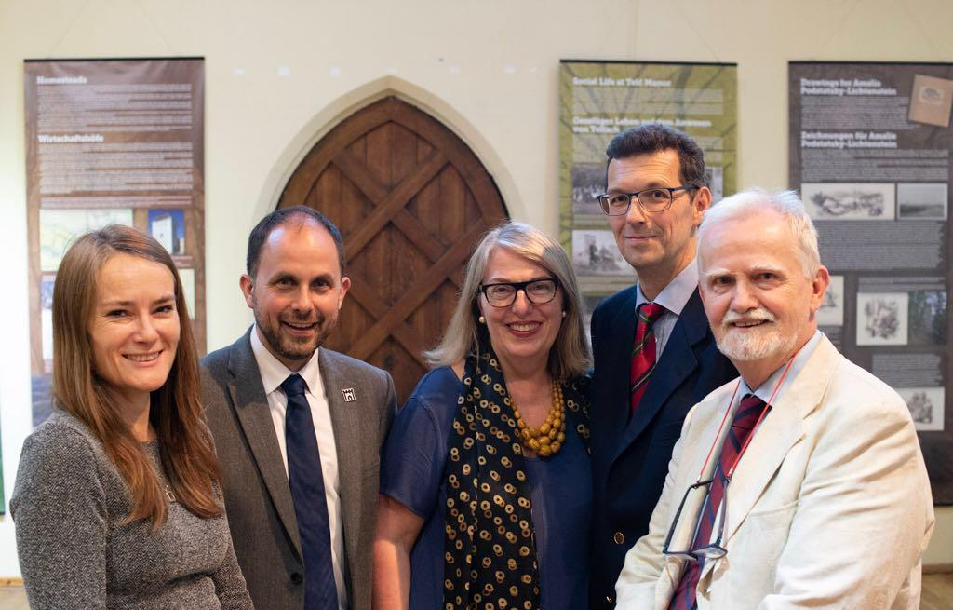
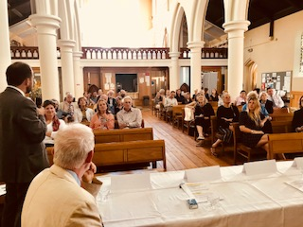
CNTA annual special events
    Celebrating 4th Anniversary of Czech National Trust June 2018, London

Slide 19
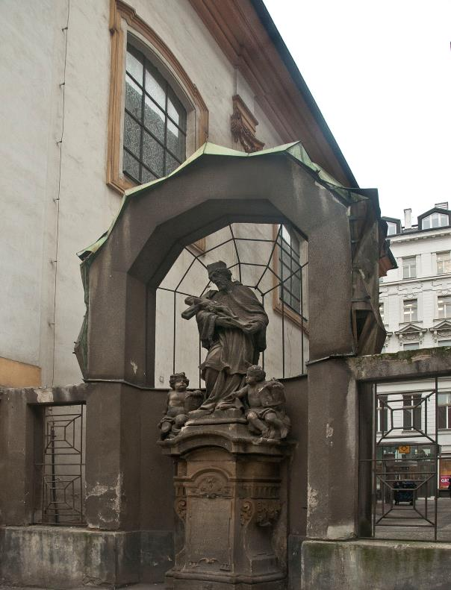
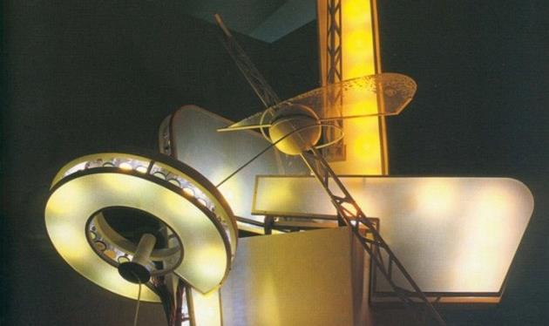
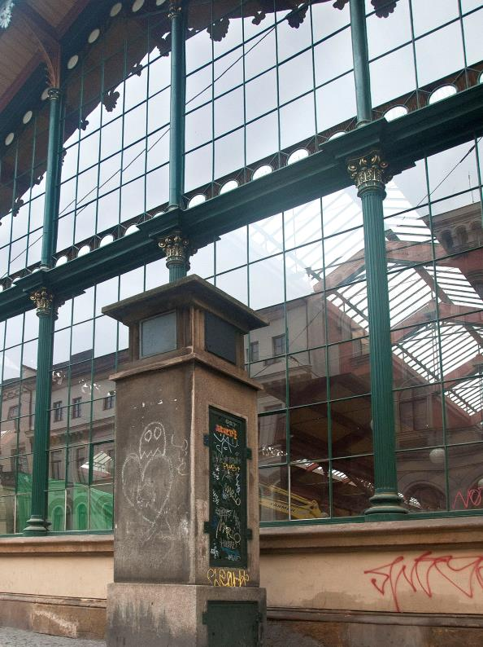
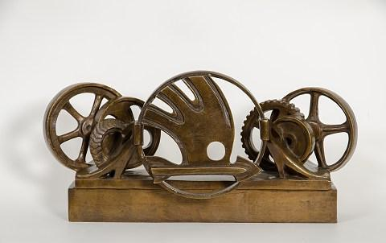
    Prague Gems
Diamant Baroque Sculpture with Cubist Frame
Zdeněk Pešánek Light Sculpture
Meteorological Columns
Otto Gutfreund Sculpture

Slide 20
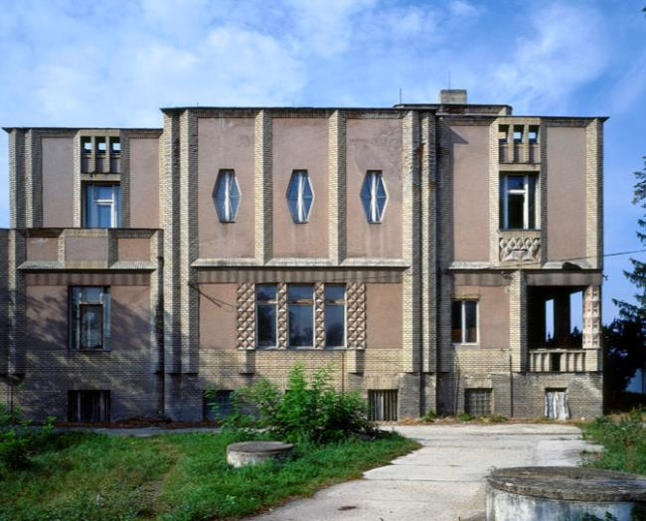

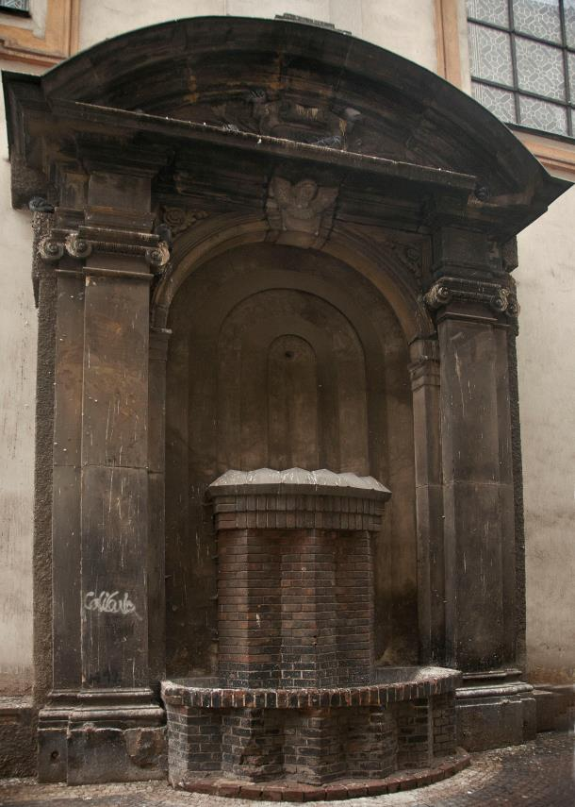
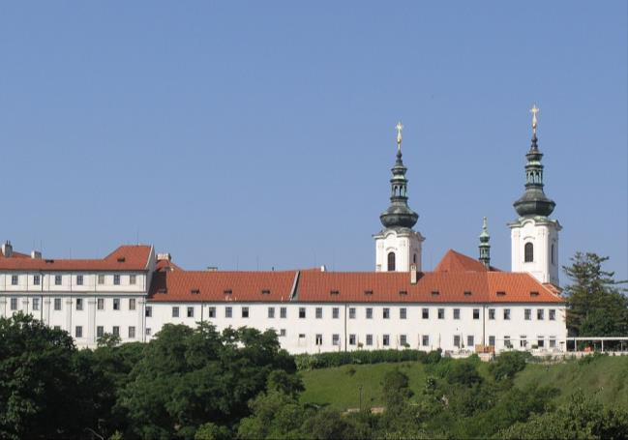
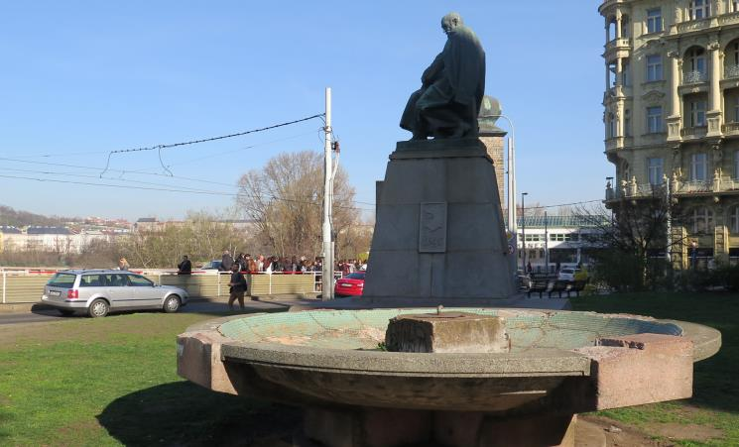
    Other Projects

Slide 21
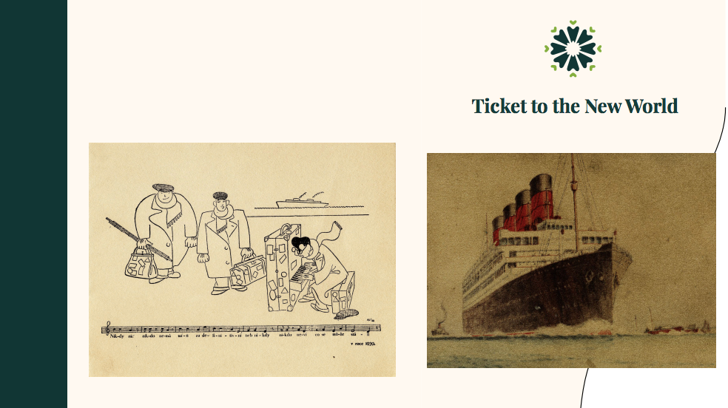
    Ticket to a New World

Slide 22
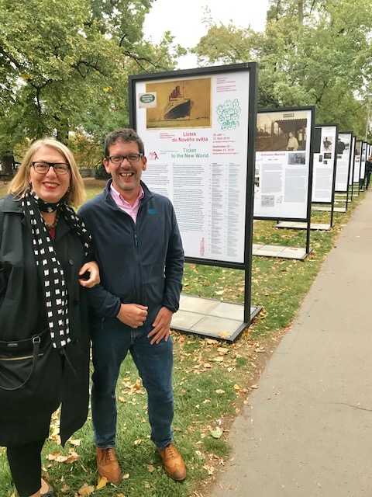
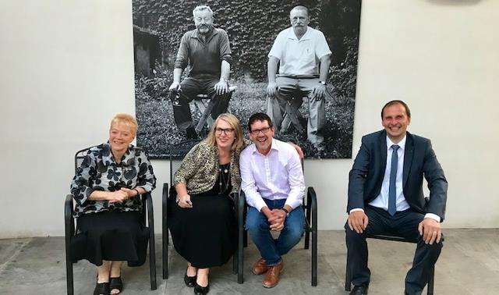
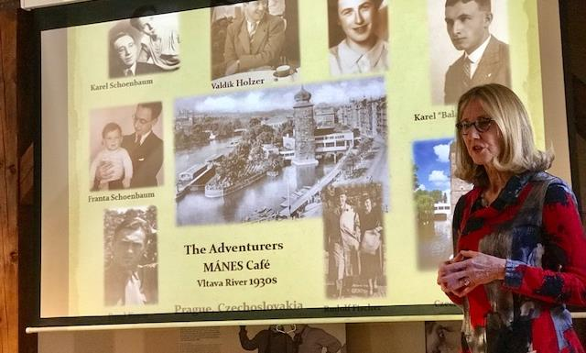
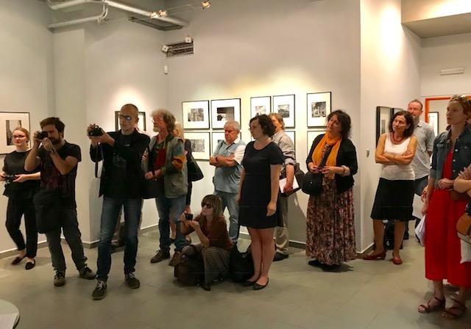
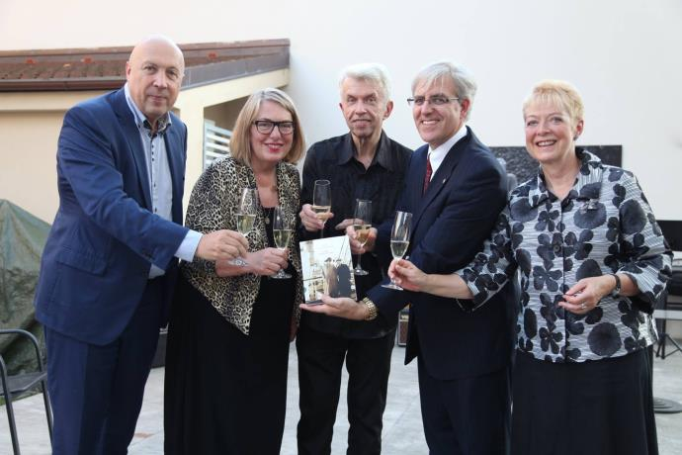
    Ticket to a New World – the opening!

Slide 23
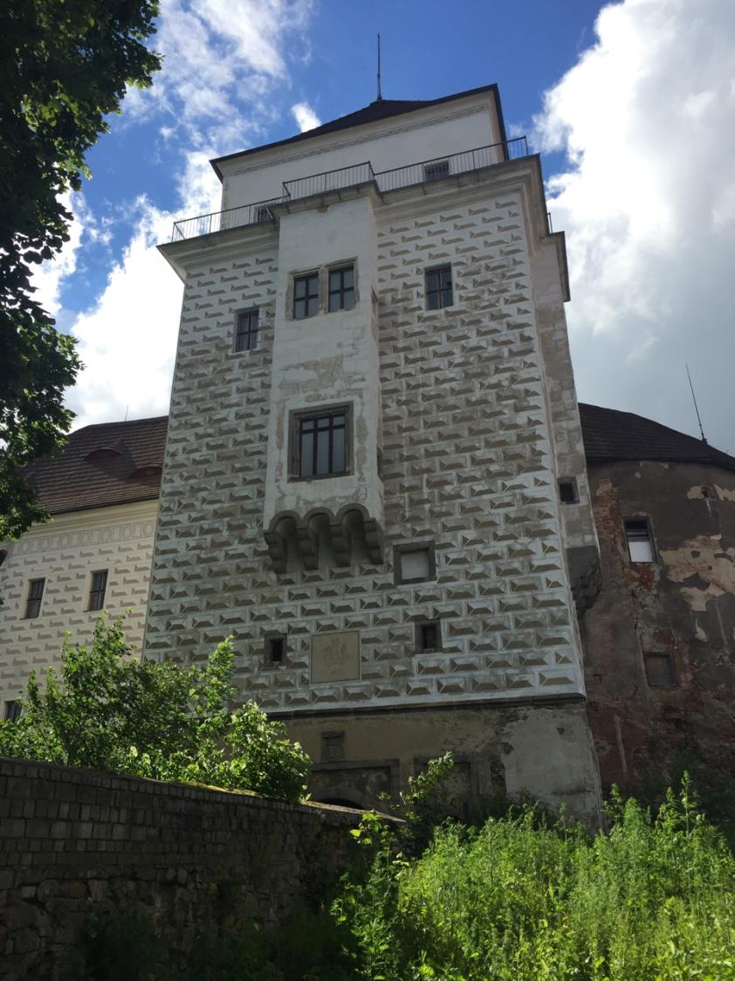
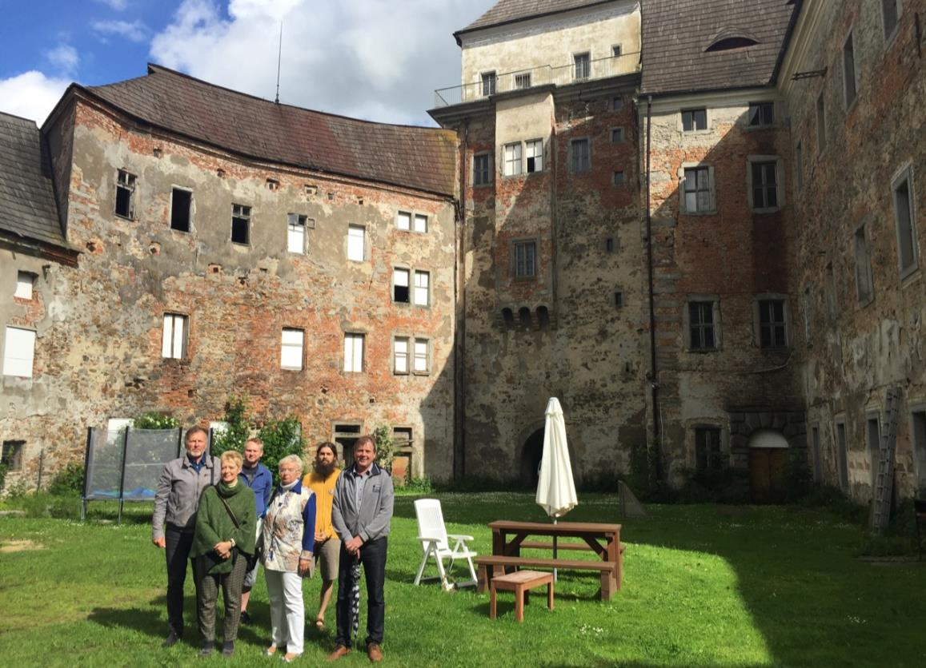
    Rožmital chatteau

Slide 24
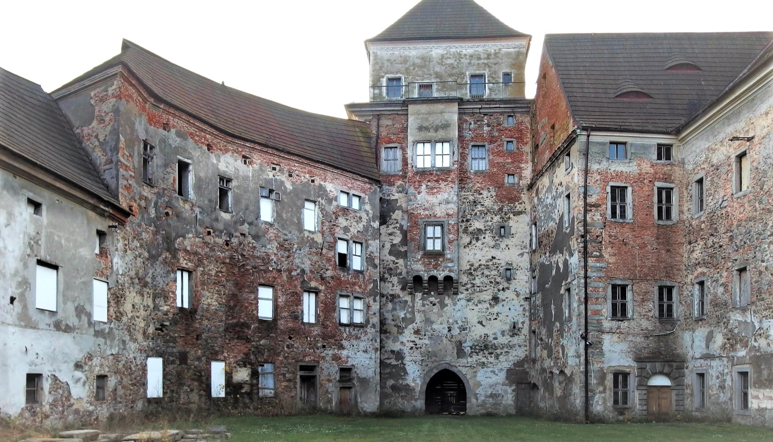

Slide 25
What next and lessons learned
Raise money from a wider base to have a secure base income
Leverage income and funds from projects
Get more volunteers, build our administrative capacity
Create a first class web site/IT capability and platform
Long term aims:
Change the balance of our finances from fund raising to revenue from the projects
Make the organisation autonomous, largely self financing and Cz based
Create a membership organisation

Slide 26
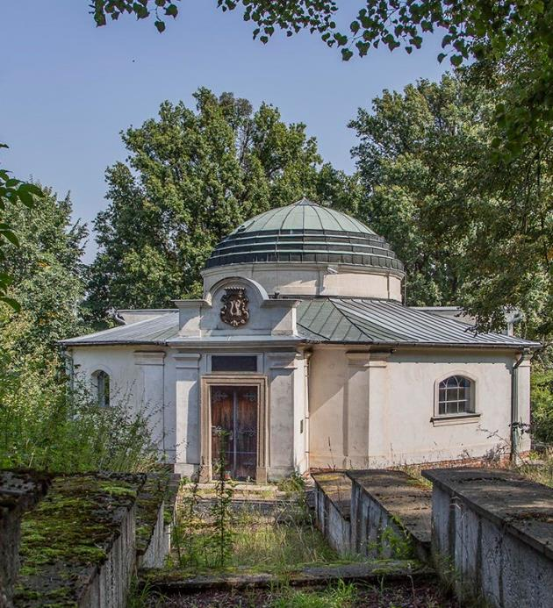
By concentrating powers and resources to save the heritage of of our country we revive the places of our national identity and bring them back to life.
Follow us: facebook.com/czechnationaltrust
Visit our website: www.czechnationaltrust.org
Donate via https://paypal.me/CNTAbroad

