Slide 4
Notes:
Kick off conference

Slide 5
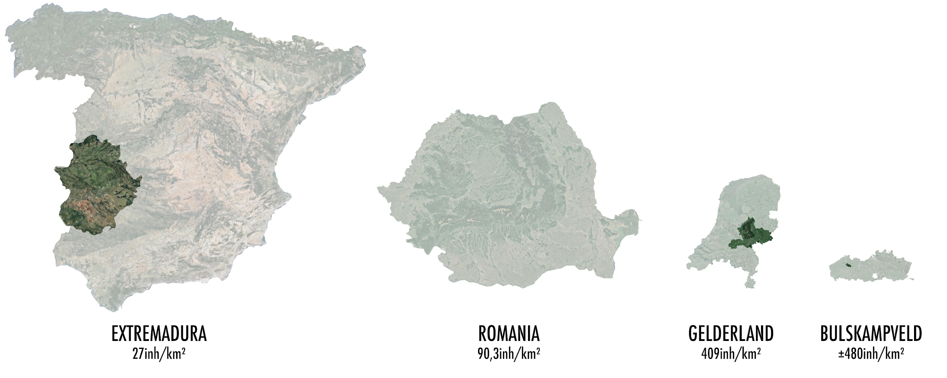
Innocastle – the regions involved
Notes:
Regions

Slide 6
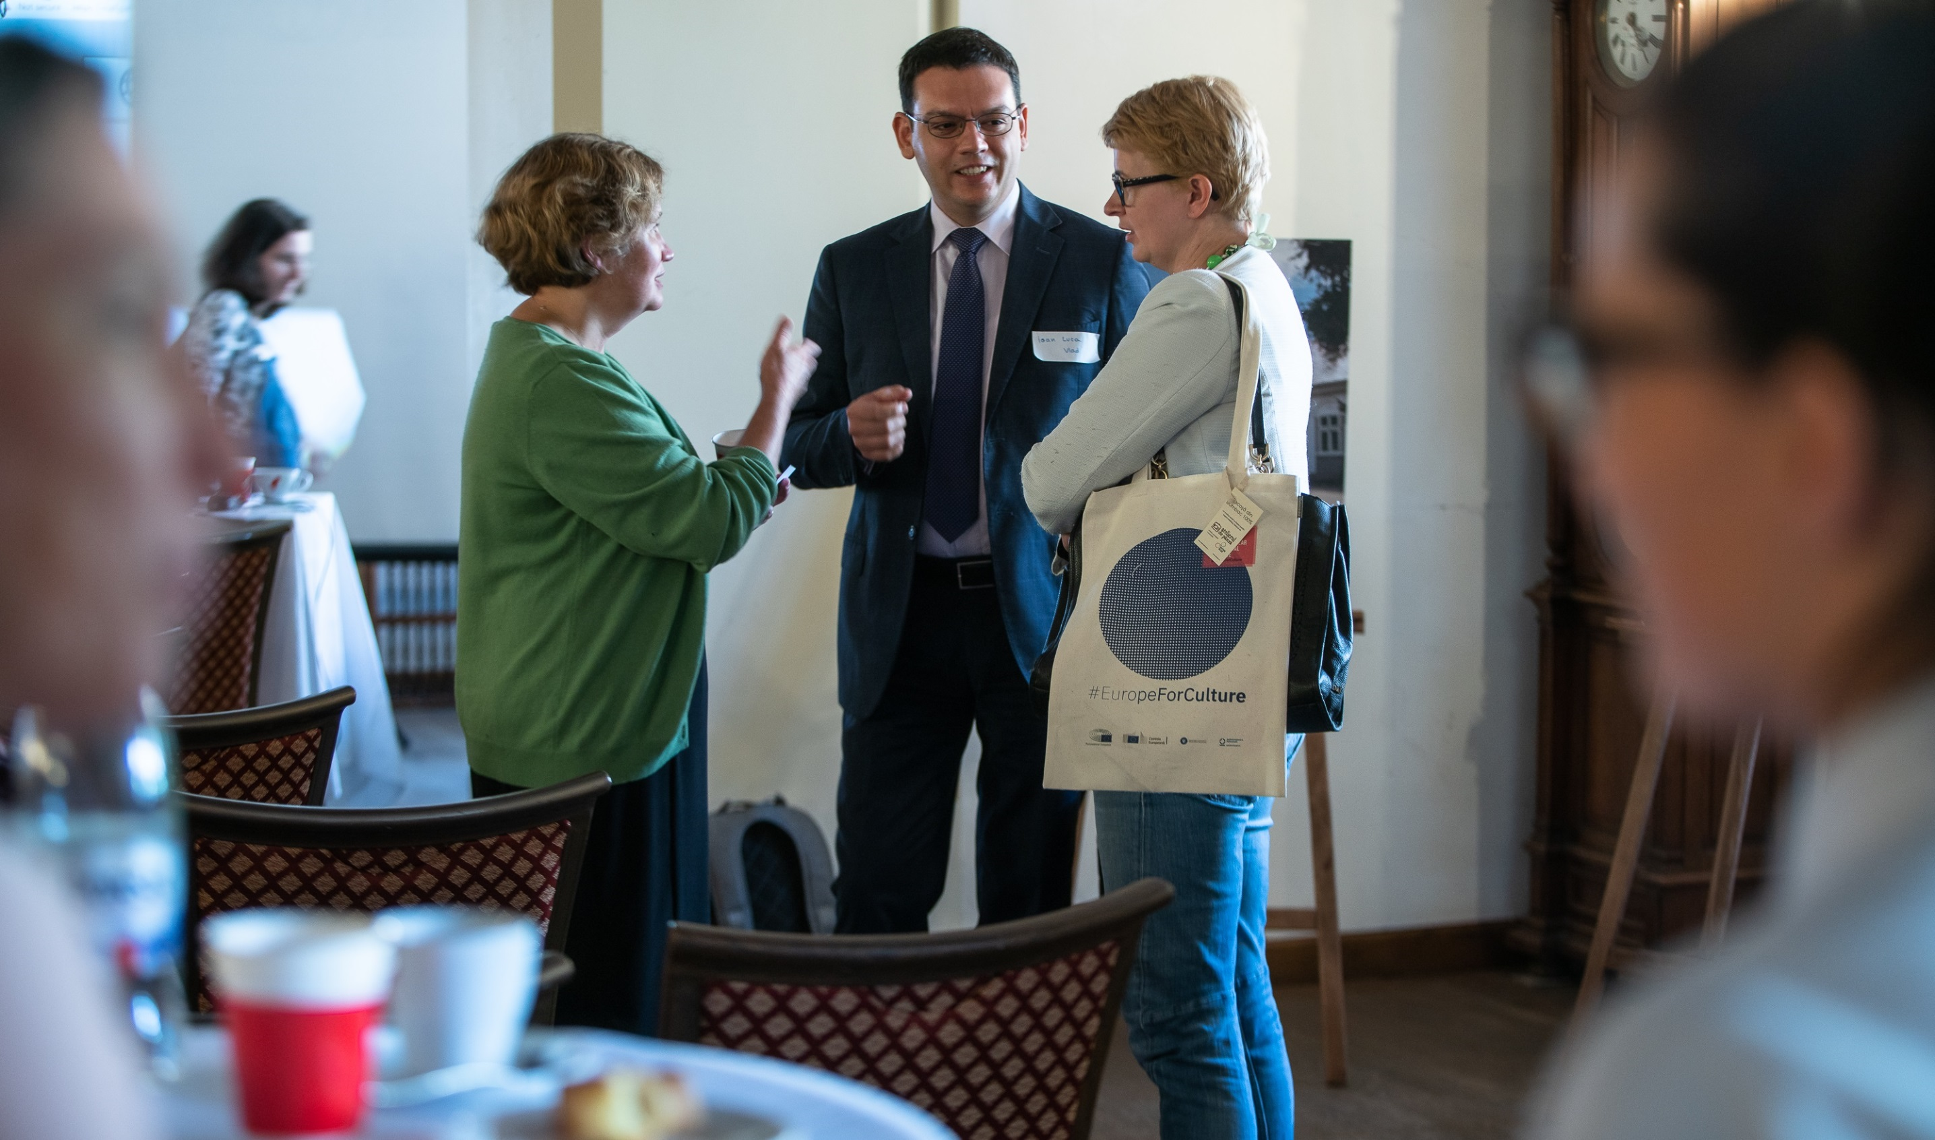
Notes:
INTO/NT role – Knowledge partner

Slide 7
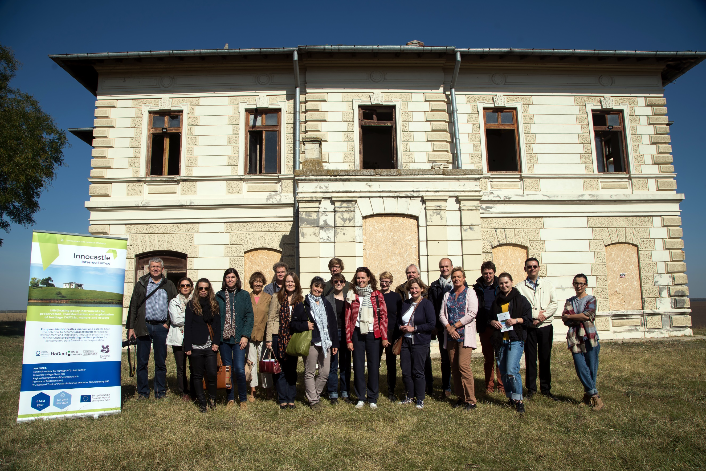

Slide 9
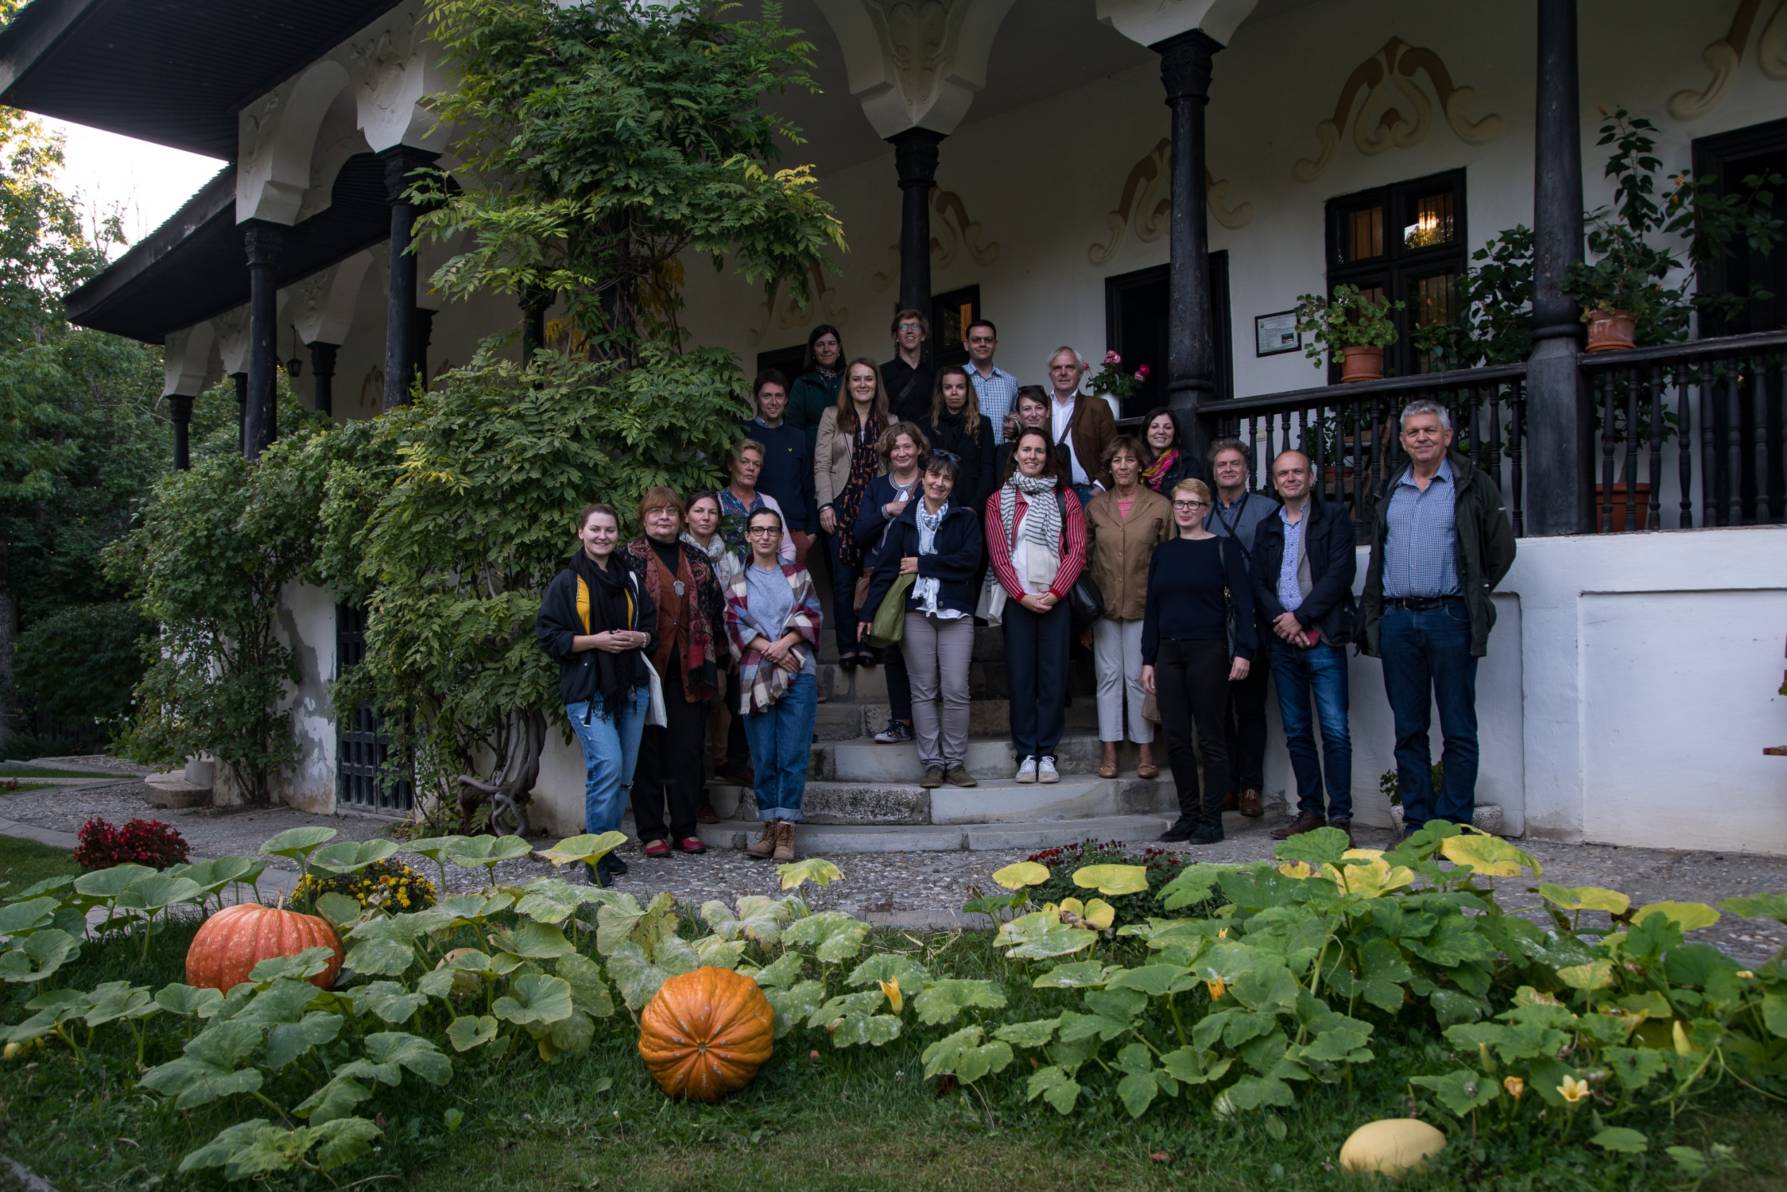

Slide 11
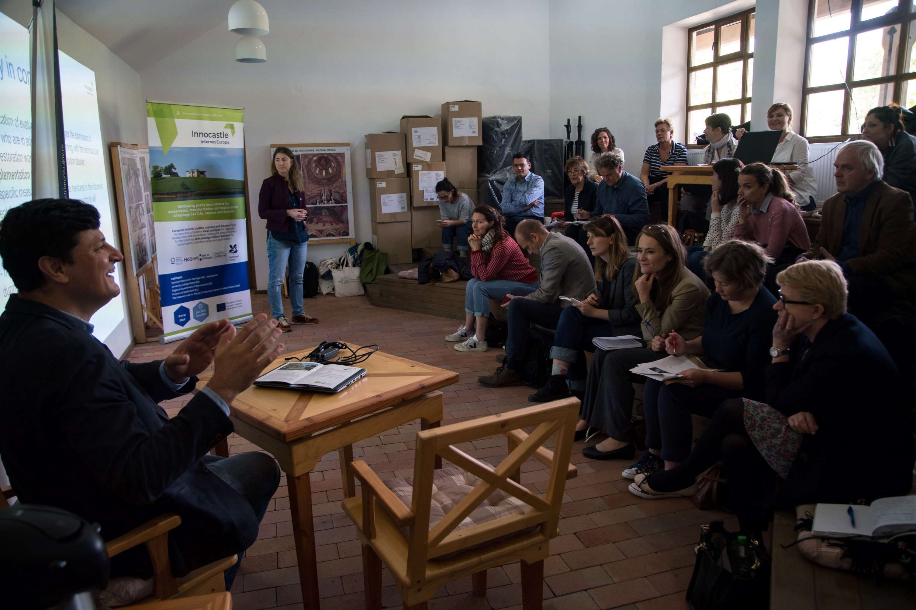
Notes:
Thematic seminar

Slide 12
